Slide 1
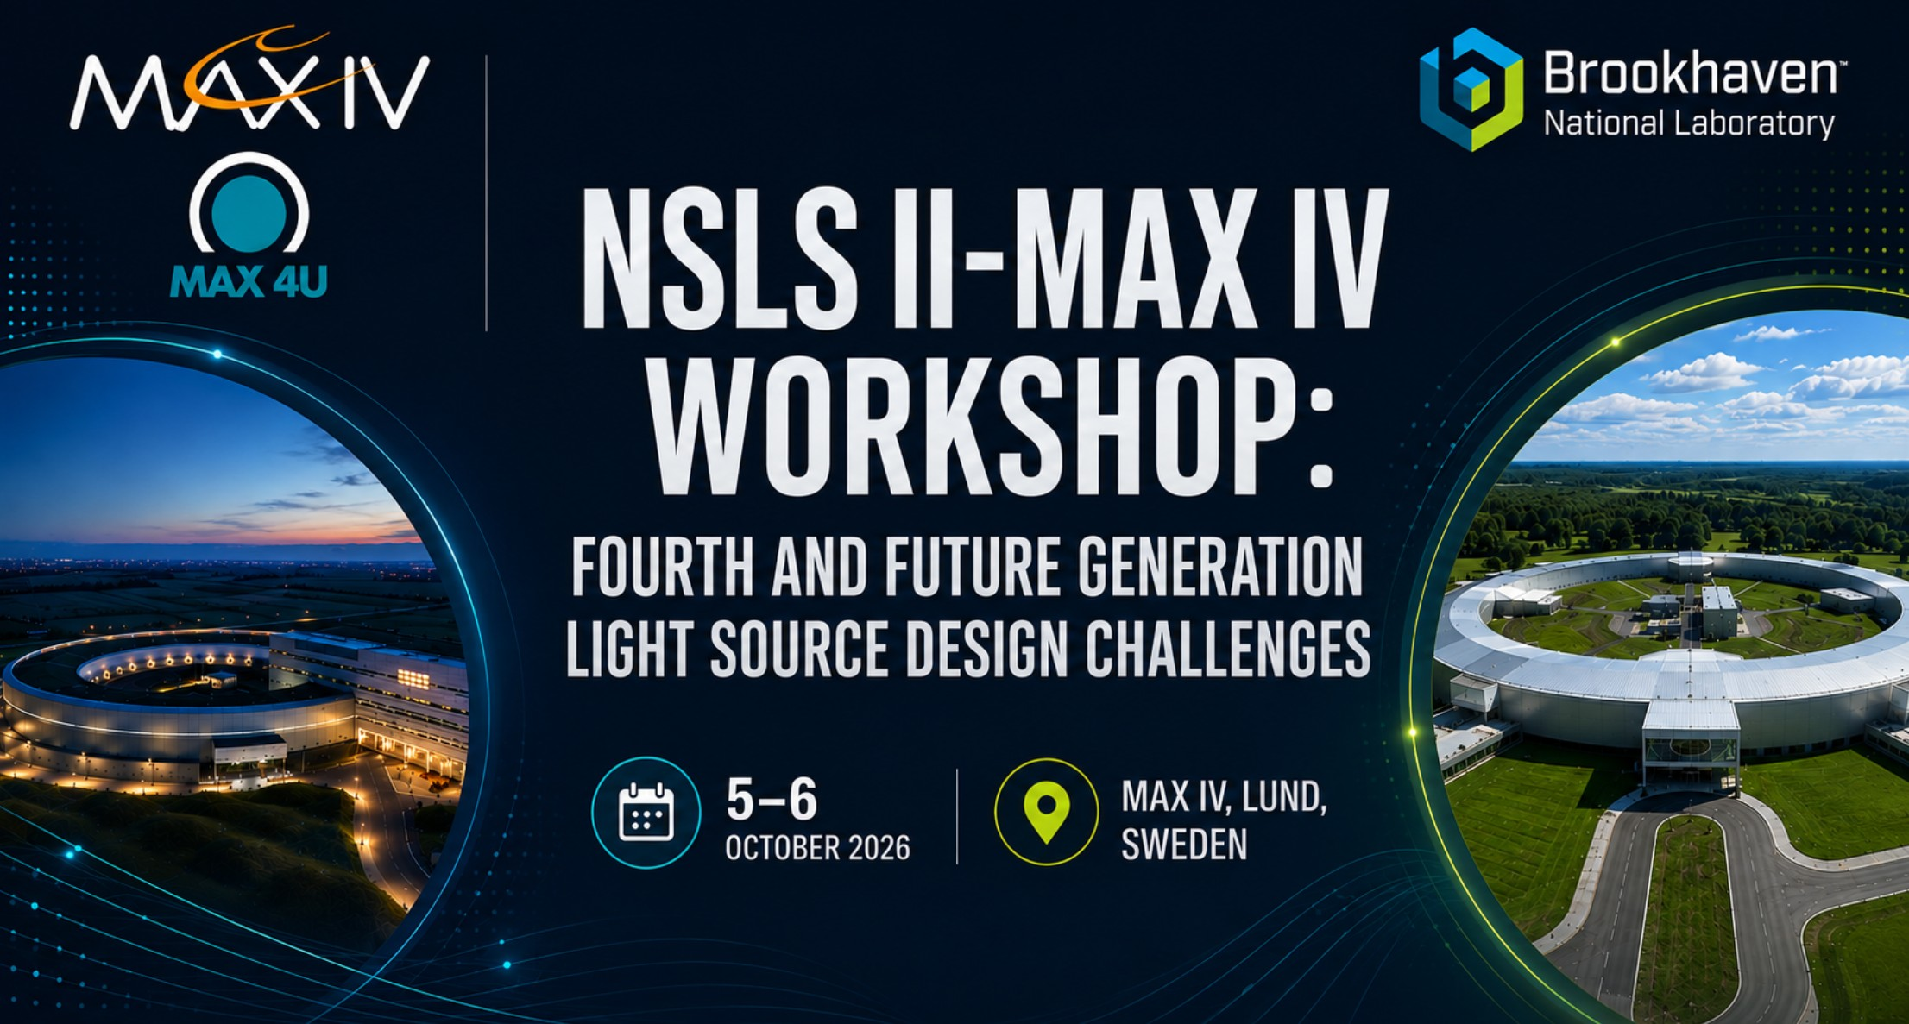
NSLS-II & MAX IV Workshop: Fourth and Future
Generation Light Source Design Challenges
Closing
Eshraq Al-Dmour

Slide 2
Possible Collaboration
MAX4U
Beam dynamics & injection
Diagnostics & feedback
Collective effects & RF
Nonlinear optics and online optimisation; off-phase injection; injection efficiency, lifetime and error sensitivity.
Small-emittance/beam-size diagnostics; visible and X-ray techniques; emittance, orbit and bunch-by-bunch feedback.
Benchmark impedance and microwave-instability models; triple-RF and harmonic-cavity simulations; feedback modelling.
Vacuum & integration
Joint validation
Synrad/Molflow+ studies, surface properties and desorption; photon heat-load criteria; alignment and absorber integration.
Exchange commissioning experience and use existing machines/test sections to validate prototypes and new concepts before upgrade installation.
Oct. 2026
NSLS II MAX IV Workshop
2

Slide 3
Acknowledgement
Timur Shaftan.
Pedro F. Tavares.
Helena Lewis.
Shandana Mufti.
Speakers.
Session chairs.
Group disucssion chairs, zoom hosts and report writing.
A special thank you to our colleagues from NSLS-II who travelled across the Atlantic to be with us in person.
Thank you also to our colleagues from NSLS-II who joined remotely and started their day early to participate.
Finally, thank you to everyone at MAX IV whose dedication and support over the past months made this workshop possible.

Slide 4
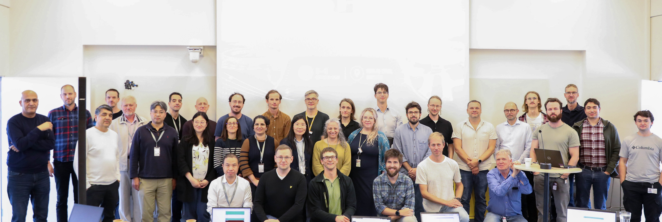

Slide 5
Thank You & Safe Travel back home

