Slide 1
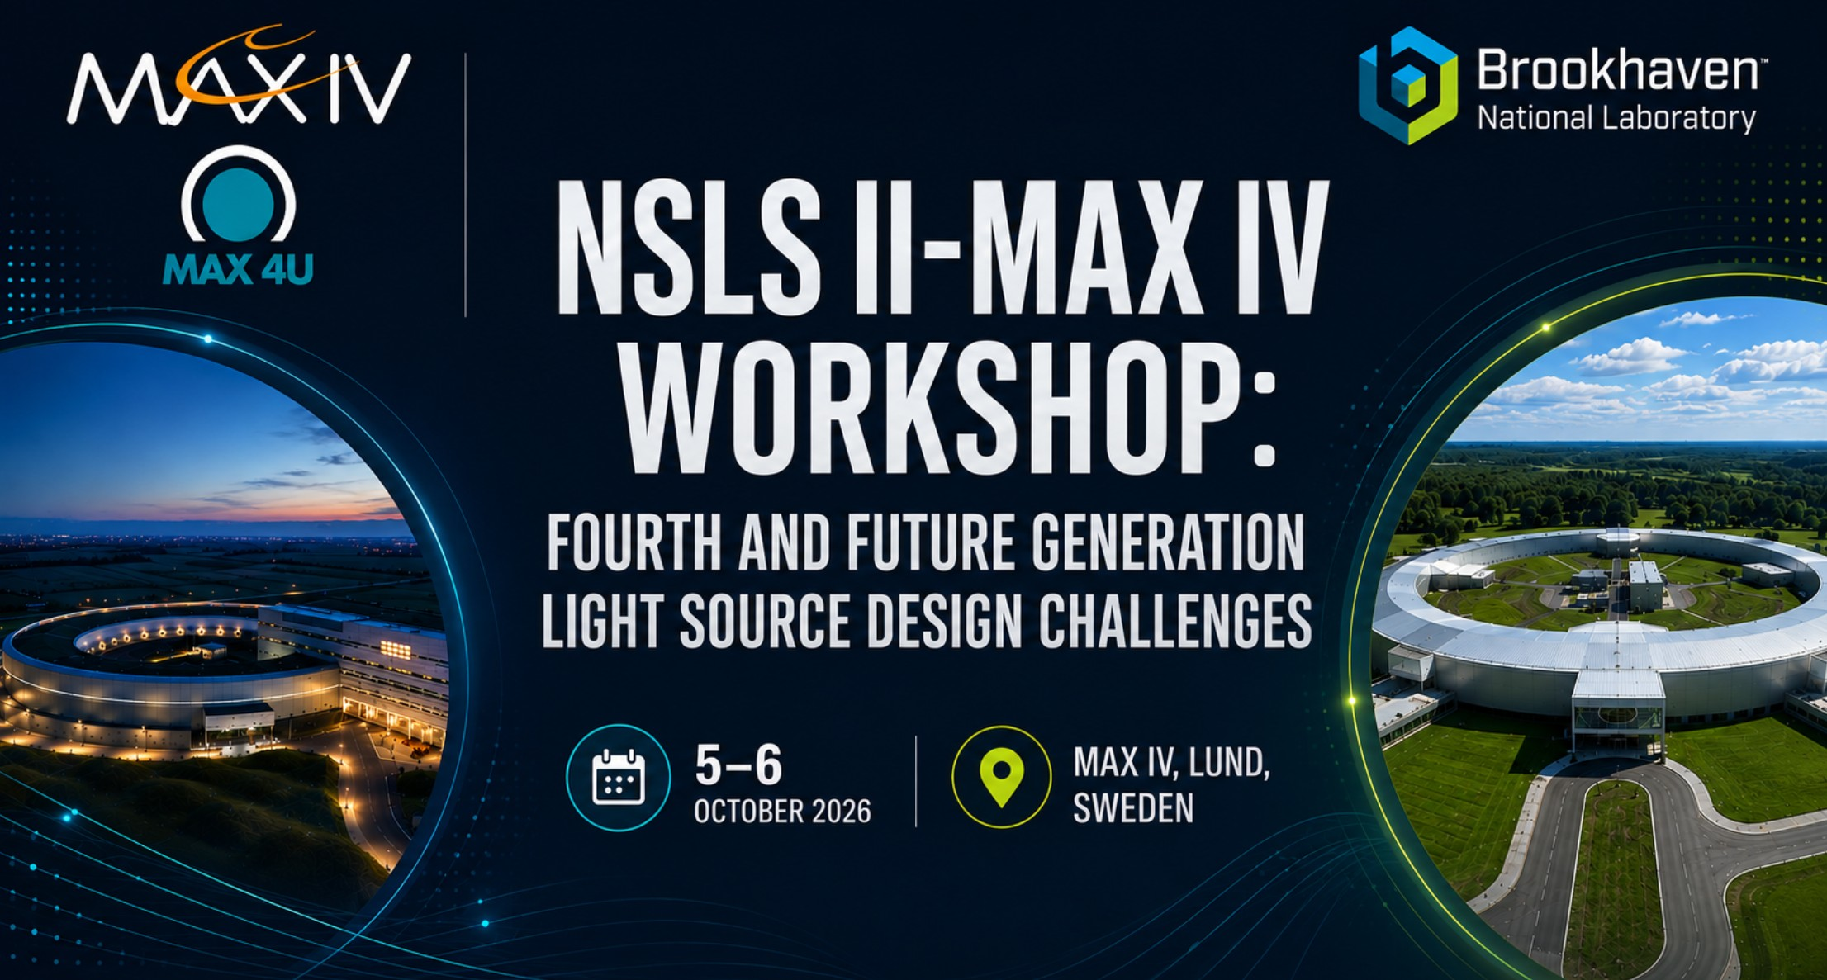
NSLS-II & MAX IV Workshop: Fourth and Future
Generation Light Source Design Challenges
Group 1
Lattice Design Approaches, ring modeling, error analysis and ML/AI-enabled opportunities for operation and design of 4th and future generation light sources
Reporting back

Slide 2
Key Takeaways
Upcoming workshop on nonlinear optimisation/control
  Control over chaos
Performance of "optimal solutions" under real-world conditions observed by both labs to be fragile
  Over-fitting under overly specific situations?
Spatial temperature stability is important for NSLSIIU, but has not appeared at all in MAXIV discussions
  ESRF-EPS considered this? SLS?
Survey/alignment for NSLSIIU will be challenging

Slide 3
Collaboration opportunities
Off-phase injection is a source of concern in both projects
  Potential area of collaboration?
Non-linear optics control & online optimisation
Error analysis
  More realistic alignment assumptions
  Simulation tools (elegant vs pyTracy for example)
Magnetic crosstalk analysis?
Symplectic tracking of complicated fields

Slide 4
Challenges / Open Questions
Lattice design: Emittance minimisation within the linear space allowed, and associated nonlinear dyn.challenges.
DA: lifetime vs. injection efficiency
Lower long-straight betas
Budget-reduction via elimination of various knobs (e.g., magnet families)
Survey/alignment for NSLSIIU will be challenging
  Alignment of bending magnet beamlines

