Slide 1
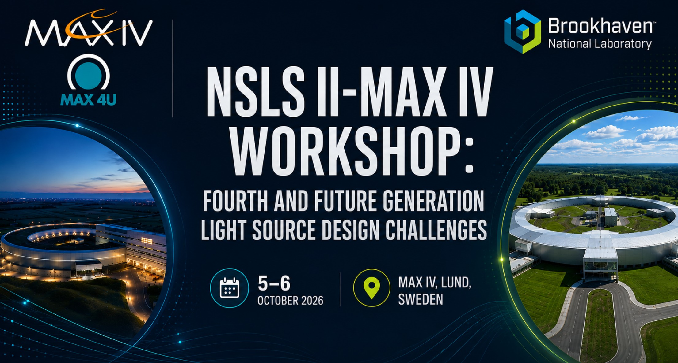
NSLS-II & MAX IV Workshop: Fourth and Future
Generation Light Source Design Challenges
Group 2
Injection System

Slide 2
Key Takeaways
The two presentations had somewhat different focus areas.
A common theme is testing new systems in the existing rings before future upgrades, to validate the concepts and reduce risk.
NSLS-II plans to replace two existing dipoles with Complex Bends and test the impact on injection, beam lifetime, and normal operation. A nonlinear kicker will also be tested for off-axis injection.
MAX IV plans to develop prototypes of the stripline kickers and high-power pulsers and test the complete system with beam in R3, and investigating the impact on injection, beam lifetime, and operation.

Slide 3
Collaboration opportunities
Exchange experience on testing and commissioning new systems in existing storage rings
Continue discussions on injection requirements and challenges for our upgrades
Explore closer collaboration with MAX IV on in-vacuum nonlinear kickers, building on their strong experience to support NSLS-II development, testing, and commissioning

Slide 4
Challenges / Open Questions
NSLS-II
Maintaining off-axis injection efficiency and beam lifetime with the reduced Complex Bend aperture.
Managing field and alignment errors, including a strategy for field adjustment flexibility in the PM design
MAX IV
Developing a fast stripline kicker and pulser system with sufficient kick strength and minimal interference with the stored beam
Demonstrating the AXPHEN injection concept with beam in R3.

