Slide 1
Håkan Rensmo
Electron spectroscopy of solar cell materials
Woodstock 1 2018

Slide 2
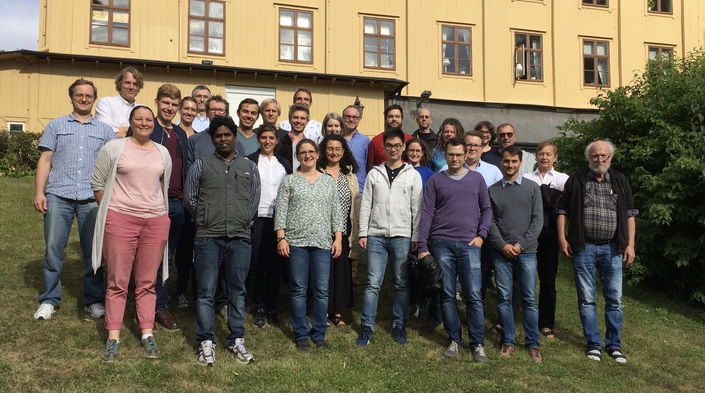
Molecular and Condensed Matter Physics
Maria Hahlin, Ida Källquist, Dibya Phyal, Bertrand Philippe, Felix Masel, Fredrik Lindgren, Sebastian Svanström,
Former members: Rebecka Lindblad, Susanaa Kaufman.Eriksson
CMD (UU) Erik Johansson, Gerrit Boschloo, Jesper Jacobson,
KTH Ute Cappel, James Gardner , Lichen Sun, Lars Kloo
SU, Michael Odelius
ÅABC (UU) Kristina Edström, Daniel Brndell,
Cambridge: Sam Stranks
EPFL: - Michael Saliba, Anders Hagfeldt
Bessy: Mihaela Gorgoi, UBjL, Föhlish, Ovsyannikov, Giangrisostomi, Bidermane, Leitner,
Notes:
From fundamental to applied science.
The success of the above is largely linked to an interdiciplinary environment.
In terms of the all aspects of methofdology development.
KOF
Specifically 8 ppeople putting this in the context of energy wit a close colaboration with applied researchers.
Environment for reserchers phd students 50 people.
How o wi bring develop new oportuniteis to energy resech , bring it out to the real applied researchers.
Excelence in developing and using the spectroscopy. And in

Slide 3
Molecular and Condensed Matter Physics
Dynamics
HAXPES
Maria Hahlin, Ida Källquist, Dibya Phyal, Bertrand Philippe, Felix Masel, Fredrik Lindgren, Sebastian Svanström,
Former members:
Rebecka Lindblad, Susanaa Kaufman.Eriksson Ute Cappel
CMD (UU) Erik Johansson, Gerrit Boschloo, Jesper Jacobson,
KTH Ute Cappel, James Gardner , Lichen Sun, Lars Kloo
SU, Michael Odelius
ÅABC (UU) Kristina Edström, Daniel Brndell,
Cambridge: Sam Stranks
EPFL: - Michael Saliba, Anders Hagfeldt
Bessy: Mihaela Gorgoi, UBjL, Föhlish, Ovsyannikov, Giangrisostomi, Bidermane, Leitner,
Notes:
From fundamental to applied science.
The success of the above is largely linked to an interdiciplinary environment.
In terms of the all aspects of methofdology development.
KOF
Specifically 8 ppeople putting this in the context of energy wit a close colaboration with applied researchers.
Environment for reserchers phd students 50 people.
How o wi bring develop new oportuniteis to energy resech , bring it out to the real applied researchers.
Excelence in developing and using the spectroscopy. And in

Slide 4
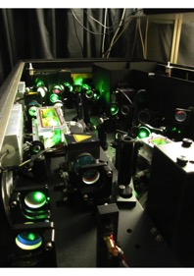
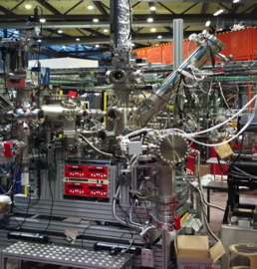
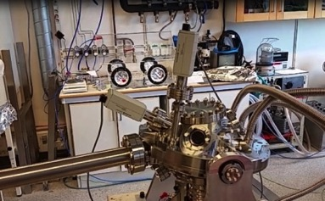
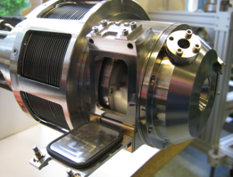
X-ray based methodology
Our main current development projects
Property | Facility | Technique
TIME RESOLVED | HELIOS (HHG @ UU) | 50 fs, 20-70 eV, time-resolved PES and bandmapping
EFFICIENT DETECTION | UBjL @ Bessy 2 | PES using ArTOF – LowDose-measurements, ps time resolution
ENVIRONMENTS I | HAXPES @ BESSY, SOLEIL, DIAMOND, DESY | PES on real buried interfaces during operations. Surface bulk. PDOS.
ENVIRONMENTS II | SPECIES, HIPPIE @ MAX IV | High pressure PES, RIXS on the Li edge
HIGH RESOLUTION | VERITAS @ MAX IV | RIXS > 30 K resolving power
New instruments
All multi million developments – The energy research very important in the scientific cases
Notes:
New opportunities –developed by us may role is to meke design so we can anserr question linked the the energy research
.

Slide 5
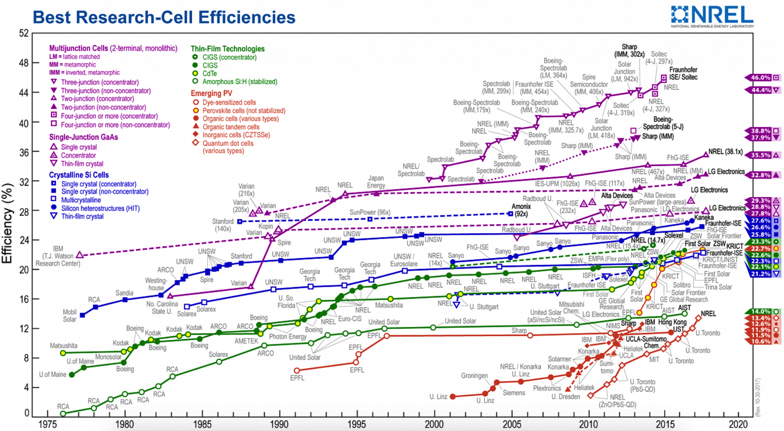
Solar Cell Materials
MODEL
SYSTEMS
COMPLEX
SYSTEMS
REAL
SYSTEMS
Notes:
Summarizing second example
We learned that the most efficient dyes have a configuration at the surface were the HOMO level is sticking out from the surface
Facilitate separation and prevent recombination.
This contributed to a new set of dye molecules allowed to a new set of material combination.
Organic I low light intensity application.
Perovskite in flexible and tandem cells
One beeing the perovskite materials inarganic.
The importance of this was then achnoledge in the new familiesof complexes that intern alowed a new generation of redox systems.
With improved properties.
This include the dramatic change removing dye molecules in this consept with perovsket inorganic (or more strictly hybrid) materials
We showed how the photon science could be used to measure how the molecule is oriented at the surface, its energy matching as well as were the electron is how it move from one side into the substrate leaving hole
Realy targeting Real systems.
This concept was then used to design new famillies of dye molecules specifically alowing the change of the electrolyte system and therby hopen for higher voltage systems.
In NREL efficiencicny shart contibuted to this push in efficiencies.
Interestingly in the sam shart there is also the apperence of a different hybrid systems refered to the perovskit solar cells statrin 2013 with values of 10 procent and that has during only a few years reached over 20 procen we have had similar values.
We have olso had an impact on this development using a similar aproch model systems and applied systems

Slide 6
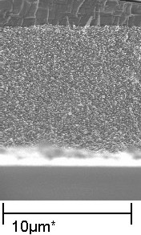
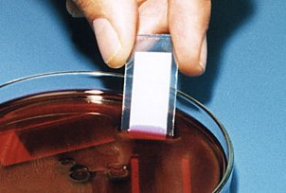
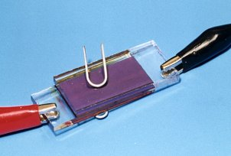
Electron spectroscopy of solar cell materials
Understand key interfacial processes in conversion
Interface structure
Dye
Where are the atoms?
Orbital
composition
Where are the electrons?
Energy matching
How to facilitate efficient charge transfer
Dynamics
How do electrons and atoms move during the conversion process.
3D design
Interface structure
Electronic structure
Goal 1: Explore, at the atomic level, the limitations of conversion due to charge dynamics.
Goal 2: Define design rules for efficient energy conversion. Indoor applications.
Notes:
The over al goal is make more efficient and more stable solarcell
The core of my activity - Understand key interfacial processes …
EXAMPLE 1: Solar energy light excite charges charge separation use in external load.
EXAMPLE 2: Battery external load to move atoms and electrons to new chemistries.
Understand the energetics at the interface. What is the energy of the charges
Understand the organistion of the atoms molecures surfaces to acomplish this.
BOTH SYSTEMS IS UNDERSTANDING CHERG TRANSPORT OVER THE INTERFACE UPON ELECtricgieal (external voltage or photovoltage)
Electronic structure. What is the energy of the electrons that are moving – how do we control the transport
Interface structure - How should the materials/molecules be arranged to accomplish this at interface surfaces.
How the electron store energy by the excitation to different energy levels and how the levels should be designe for charge separation.
How the atoms should be arranged to accopmplsh thus
Solar cells you have a system. Iluminatete you get charge carriers that you have to separate,alow you to tak out the energy in an external load.
Electronic or atomic picture.
Batteries.
Store energy by using a voltage that move charge and creat charged.
In an electon ocr energy level diafram we have move lift and move charges and stor them at different energy levels and thes levels have to match for for directing the process.
Similarly for the battry we move electrons in energy rich electons t and that will bring move the litium ions atoring the energy.
Batteries move Li ions.
Molecular functinal system/solar cell need an arrangment that facilitate the specific process.
-------------------
Methylammonium lead iodide
Hybride material.
Depending on the diffusion length varsus the absortion coefficient.

Slide 7
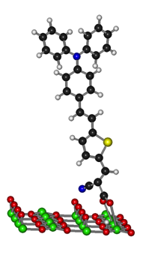
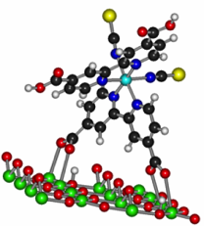
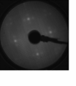
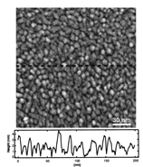
Example on atomic level understanding –
Light to electrical energy conversion using dye molecules
Interface structure
Example 1
Core levels
MODEL
SYSTEMS
COMPLEX
SYSTEMS
REAL
SYSTEMS
Notes:
The battery examples shouwed the methodology development.
An example from light to electrical enery conversion using dye molecules.
The dye- absorbing vissible ligt is the key component in this system and we have invetigatd forst its structure at the surface – interface structure.
By measuring model systems. AUndersting the structure of molecules at.
Based on this Investigate mor COMPLEX systems with dye molecules onnaonostructured surfaces
And then expose these surfeces to liquids we can undesrstand the structure of real/applied interfaces.

Slide 8

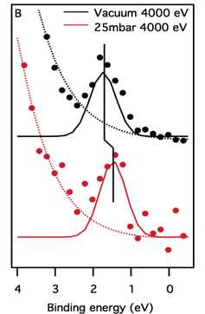
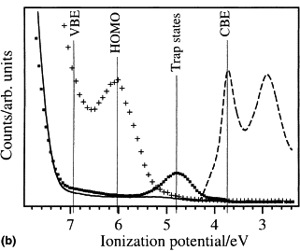
Example on atomic level understanding –
Light to electrical energy conversion using dye molecules
Energy matching
Example 1
Valence levels
MODEL
SYSTEMS
COMPLEX
SYSTEMS
REAL
SYSTEMS
Notes:
In the sam manner.
Similarly.
Investigating valence levels.
Information about the energy matching.
Simple systems
VBE, HOMO LEVEL and trapstates.
Comparing complex systems Understand how molecular design changes these energy levels,fintuning and finaly aproch realsystems measuring under highe presure with e.g. water understand what happens in real systems.

Slide 9
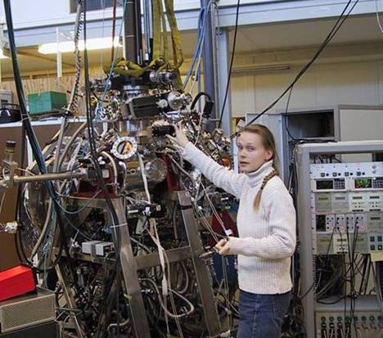
+ an undulator giving a lifetime in the storage ring of an hour

Slide 10
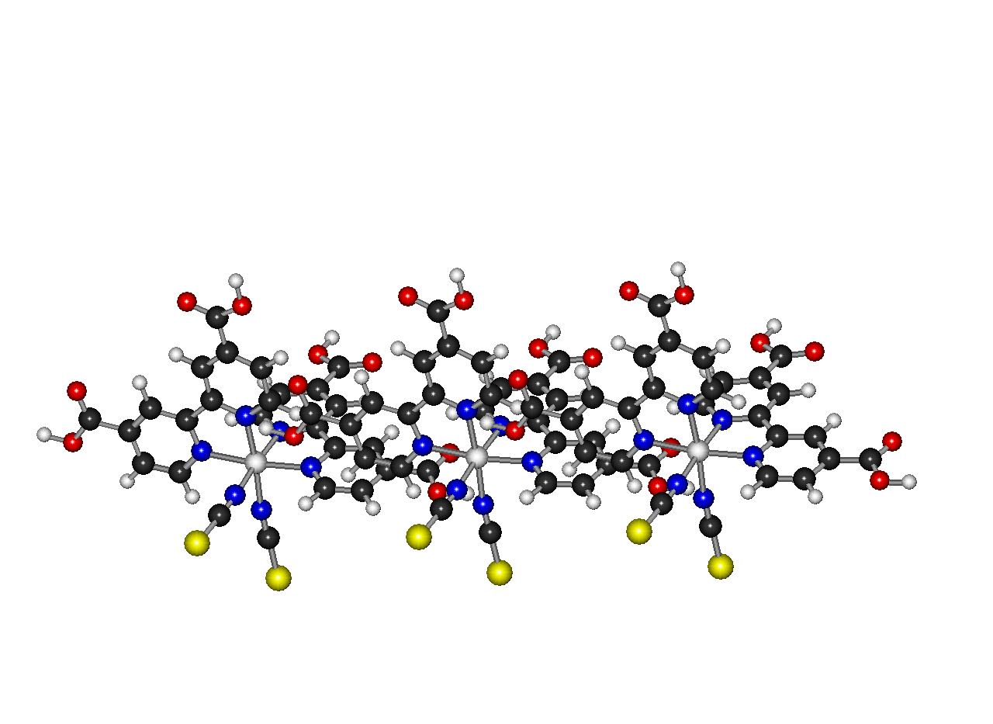
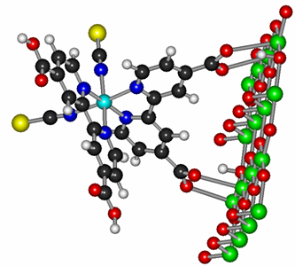
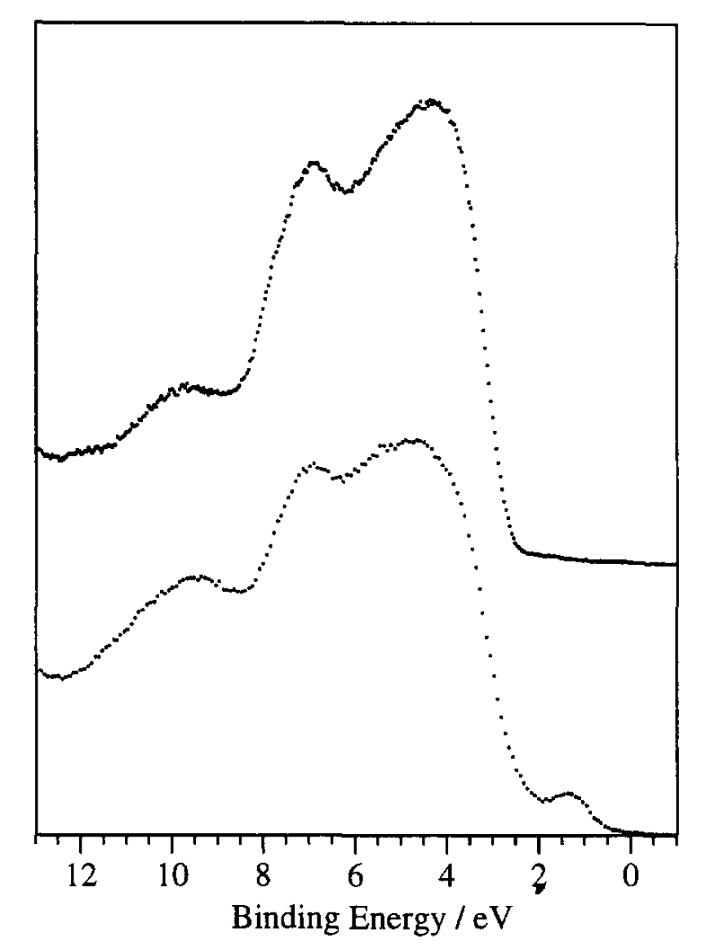
1996

Slide 11
PES (XPS), Y-axis
Property | Facility | Technique
ENVIRONMENTS I | HAXPES @ BESSY, SOLEIL, DIAMOND, DESY | PES on real buried interfaces during operations. Surface - bulk. PDOS.
I_{a} ∝ ρ_{a} ∗ σ_{a}(hν,θ) ∗ exp [−z/Λ(Ε_{k})]
BESSY,
Diamond
BL51
BLI41
hν
Depth of the
analysis
≈ 3 IMFP = f (E_{kin})
Variation of the
photon energy (hν)
“Universal curve”
Soft X-ray: MAX IV
h ν = 50 - 1500 eV
E_{kin} tunable for each core peak
C1s
E_{b}=285 eV
E_{k} = 1202 eV
In-house XPS
hν=1487 eV
E_{kin} fixed for each core peak
E_{kin} = hν - E_{b}
Hard x-ray: Bessy II
h ν = 2000 – 10,000 eV
E_{kin} tunable for each core peak

Slide 12
PES (XPS), Y-axis
Property | Facility | Technique
ENVIRONMENTS I | HAXPES @ BESSY, SOLEIL, DIAMOND, DESY | PES on real buried interfaces during operations. Surface bulk. PDOS.
I_{a} ∝ ρ_{a} ∗ σ_{a}(hν,θ) ∗ exp [−z/Λ(Ε_{k})]
BL51
BESSY,
Diamond
BLI41
hν
E_{kin} = hν - E_{b}

Slide 13
Example on atomic level understanding –
Light to electrical energy conversion using dye molecules
Orbital
composition
Example 1
MODEL
SYSTEMS
COMPLEX
SYSTEMS
REAL
SYSTEMS
Ligand to Ligand Charge transfer
Long lifetime
HOMO CHARACTER: 2/3 Ru4d +1/3 NCS p
Notes:
Used our spectroscopy in a more advance way.
The electron that move around is sometimes refered to as the HOMO
Were is this HOMO electron. The Experimentaly that the HOMO level is distributed at the metalic centar and at the Supher lignands. Sticking out from the surface.
We can do more advanced spectroscopy were we by selection of energies can investigate how particular atoms conmtribut to the valence level or specificvaly the HOMO level which is the lectron with the smallest binding energy, the electron that interact with light in a solar cell and then move around.
For example nitrogen DARK blu atoms her and ruthenium and Ruthenium levels here AND the <lIGHT BLUE. Get
A state with a LONG lifetime
Lonfg lifetiem

Slide 14
Example on atomic level understanding –
Light to electrical energy conversion using dye molecules
Energy matching
Example 1
Valence levels
MODEL
SYSTEMS
COMPLEX
SYSTEMS
REAL
SYSTEMS
Notes:
In the sam manner.
Similarly.
Investigating valence levels.
Information about the energy matching.
Simple systems
VBE, HOMO LEVEL and trapstates.
Comparing complex systems Understand how molecular design changes these energy levels,fintuning and finaly aproch realsystems measuring under highe presure with e.g. water understand what happens in real systems.

Slide 15
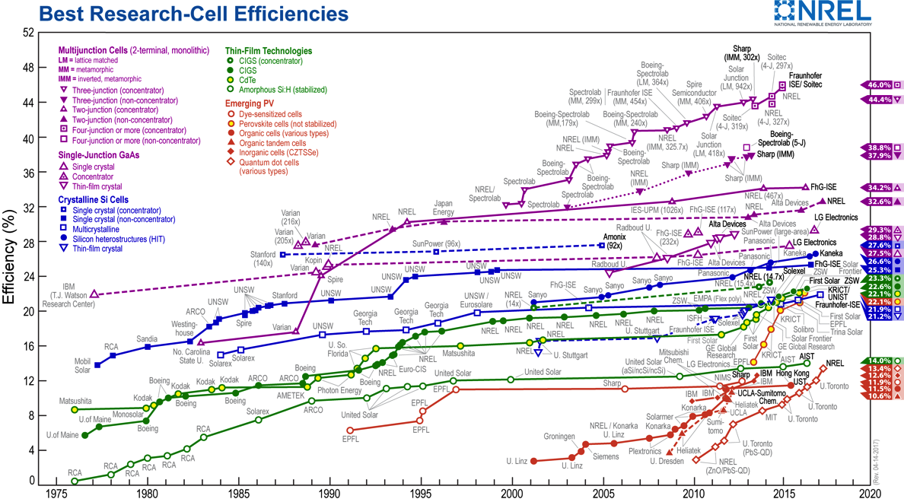
Example on atomic level understanding –
Light to electrical energy conversion using dye molecules
Example 1
MODEL
SYSTEMS
COMPLEX
SYSTEMS
REAL
SYSTEMS
Johansson, EMJ et al. Chem. Phys. Chem. 2014,15, 1006 (refs. therein)
Notes:
Summarizing second example
We learned that the most efficient dyes have a configuration at the surface were the HOMO level is sticking out from the surface
Facilitate separation and prevent recombination.
This contributed to a new set of dye molecules allowed to a new set of material combination.
One beeing the perovskite materials inarganic.
The importance of this was then achnoledge in the new familiesof complexes that intern alowed a new generation of redox systems.
With improved properties.
This include the dramatic change removing dye molecules in this consept with perovsket inorganic (or more strictly hybrid) materials
We showed how the photon science could be used to measure how the molecule is oriented at the surface, its energy matching as well as were the electron is how it move from one side into the substrate leaving hole
Realy targeting Real systems.
This concept was then used to design new famillies of dye molecules specifically alowing the change of the electrolyte system and therby hopen for higher voltage systems.
In NREL efficiencicny shart contibuted to this push in efficiencies.
Interestingly in the sam shart there is also the apperence of a different hybrid systems refered to the perovskit solar cells statrin 2013 with values of 10 procent and that has during only a few years reached over 20 procen we have had similar values.
We have olso had an impact on this development using a similar aproch model systems and applied systems

Slide 16
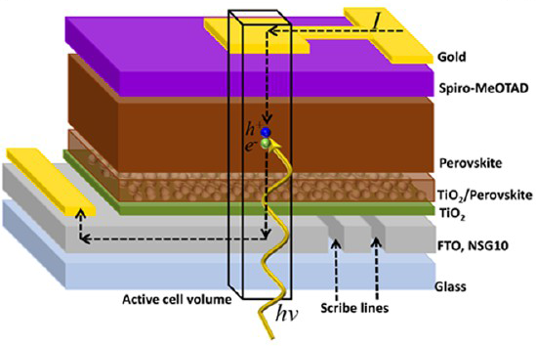
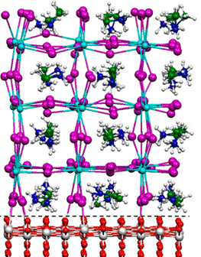
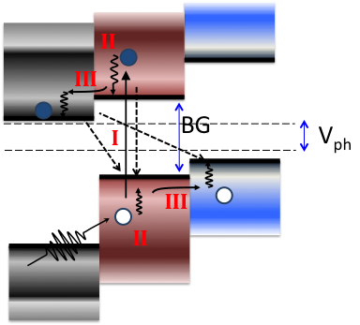
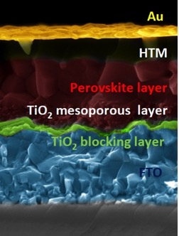
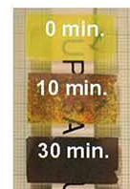
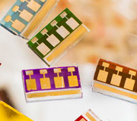
Electron spectroscopy of solar cell materials
Understand key interfacial processes in conversion
Interface structure
Where are the atoms?
Orbital
composition
Where are the electrons?
Energy matching
3D design
Interface structure
Electronic structure
How to facilitate efficient charge transfer
Dynamics
How do electrons and atoms move during the conversion process.
Goal 1: Explore, at the atomic level, the limitations of conversion due to charge dynamics.
Goal 2: Define design rules for efficient energy conversion.
Notes:
The over al goal is make more efficient and more stable solarcell
The core of my activity - Understand key interfacial processes …
EXAMPLE 1: Solar energy light excite charges charge separation use in external load.
EXAMPLE 2: Battery external load to move atoms and electrons to new chemistries.
Understand the energetics at the interface. What is the energy of the charges
Understand the organistion of the atoms molecures surfaces to acomplish this.
BOTH SYSTEMS IS UNDERSTANDING CHERG TRANSPORT OVER THE INTERFACE UPON ELECtricgieal (external voltage or photovoltage)
Electronic structure. What is the energy of the electrons that are moving – how do we control the transport
Interface structure - How should the materials/molecules be arranged to accomplish this at interface surfaces.
How the electron store energy by the excitation to different energy levels and how the levels should be designe for charge separation.
How the atoms should be arranged to accopmplsh thus
Solar cells you have a system. Iluminatete you get charge carriers that you have to separate,alow you to tak out the energy in an external load.
Electronic or atomic picture.
Batteries.
Store energy by using a voltage that move charge and creat charged.
In an electon ocr energy level diafram we have move lift and move charges and stor them at different energy levels and thes levels have to match for for directing the process.
Similarly for the battry we move electrons in energy rich electons t and that will bring move the litium ions atoring the energy.
Batteries move Li ions.
Molecular functinal system/solar cell need an arrangment that facilitate the specific process.
-------------------
Methylammonium lead iodide
Hybride material.
Depending on the diffusion length varsus the absortion coefficient.

Slide 17
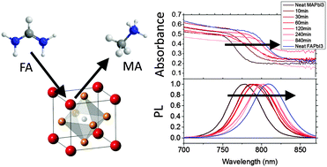
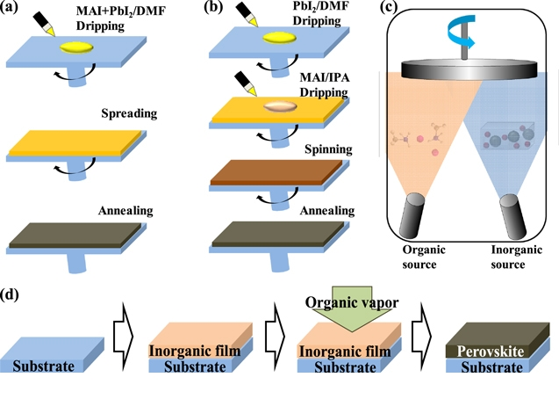
Synthesis
Simple: 2 salt solutions, e.g PbI₂ + MAI
MA
Figure 6 from Recent progress in efficient hybrid lead halide perovskite solar cells
Jin Cui et al 2015 Sci. Technol. Adv. Mater. 16 036004
doi:10.1088/1468-6996/16/3/036004

Slide 18
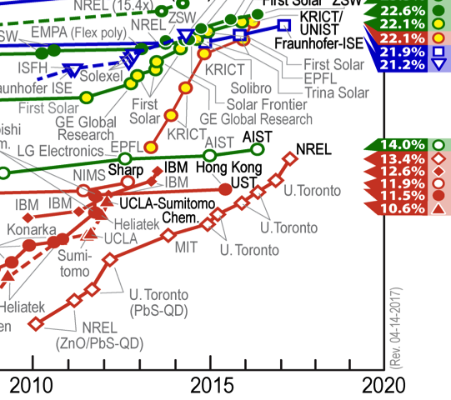
Examples: Lead-based halide perovskite
HAXPES and SOXPES
MAPbI₃
MAPb(I_{1-x}Br_{x})_{x}
Time
FA_{x}MA_{1-x}Pb(I_{1-x}Br_{x})₃
Multi cation (K⁺, Cs⁺, MA⁺, FA⁺) mixed perovskite
(Also: attempts to replace Pb to Bi, Sn, Sn, Ag)
FA MA

Slide 19
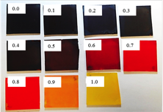
TiO₂/ CH₃NH₃PbI₃ band alignment
Energy matching
MAPb(I_{1-x}Br_{x})_{x}
MAPbI₃
2010 eV
2.1 eV
VB edge
VB edge
Energy calibrate versus the substrate, i.e. versus TiO₂ core level peak (Ti 2p_{3/2})
see also Philip Schulz et al. Energy Environ. Sci. , 2014.
Notes:
Energy level matching
Energy alignment energy calibrated using the substrate signal Ti2p3/2

Slide 20
XPS gives
Partial DOS (not DOS)
Orbital
composition
FA_{0.85}MA_{0.15}Pb(I_{0.85}Br_{0.15})₃
Measurements at high energy mainly measure the PbX₆-unit

Slide 21
Orbital
composition
Odelius (Stockholm University)
FA_{0.85}MA_{0.15}Pb(I_{0.85}Br_{0.15})₃
The top of the valence band has Pb6s - I5p (or Br4p ) anti - bonding character. Defect tolerant.

Slide 22
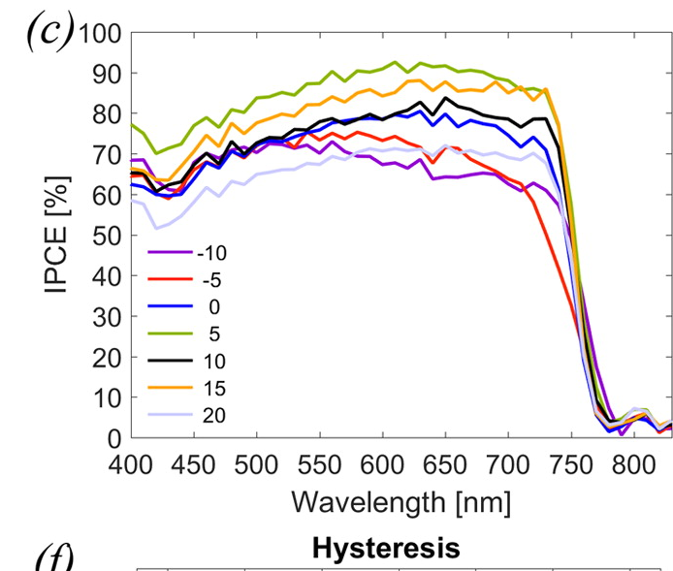
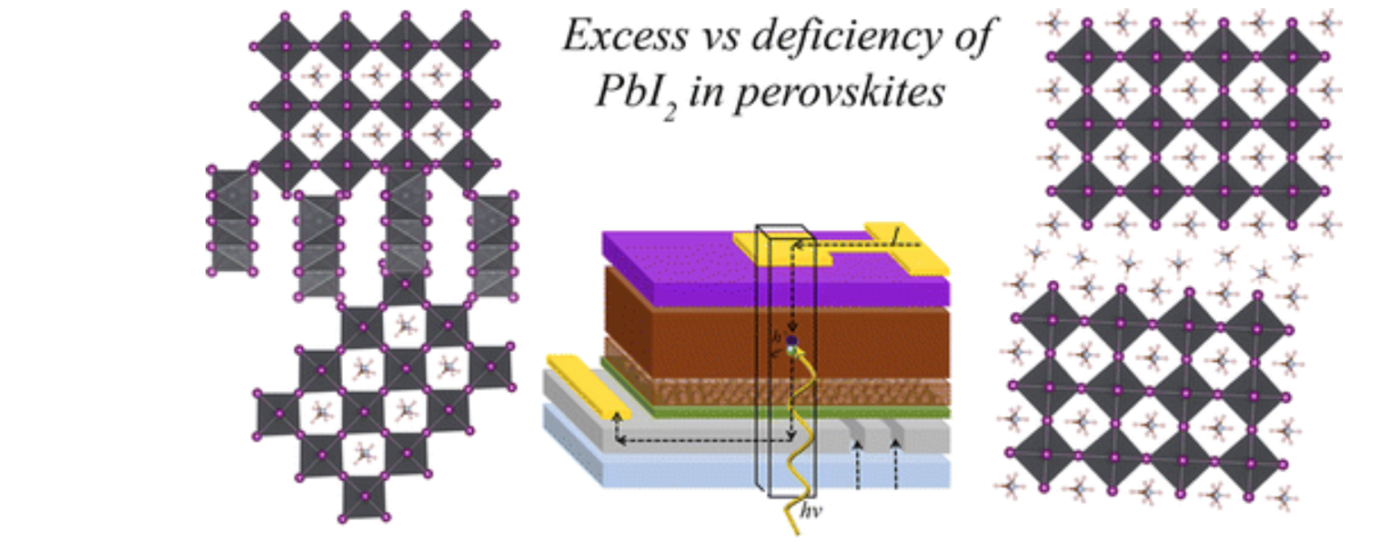
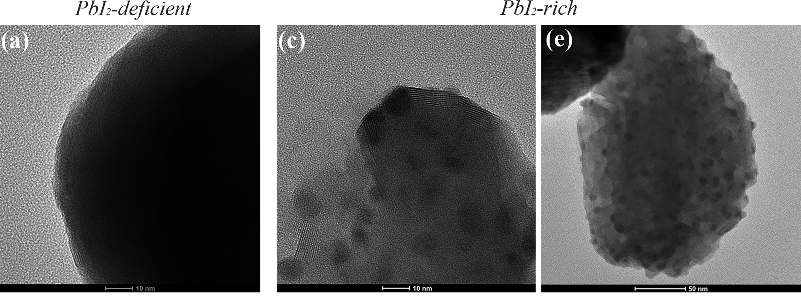
Interface structure
FA_{x}MA_{1-x}Pb(I_{1-x}Br_{x})₃
Investigation of a mixed perovskie (FA_{0.85}MA_{0.15}Pb(I_{0.85}Br_{0.15})₃)
-10% PbI₂
Stoichiometric (0%)
(c) +10% PbI₂
Theo ≈ 2.55
Interpretation of the data
Jacobsson et al. JACS 2016, 138, 10331−10343
EXCESS PbI₂ FAVOURS PHOTOCURRENT AND EFFIVIENCY
(minimize organic layers that prevent charge transport)
Notes:
2.55 I/Pb is expected
This is in line with the PES-results and points toward a
crystallization process where the perovskite grains are grown
from the outside of PbI2 -grains by diff usion and intercalation of
the organic ions. A surplus of organic ions would facilitate
complete conversion whereas a defi ciency of organic ion may
leave small pockets of unreacted amorphous PbI2 within the
perovskite grains

Slide 23
efficient luminescence=high PV efficienccy
Multi cation (K⁺, Cs⁺, MA⁺, FA⁺) mixed perovskite
M. Abdi-Jalebi, et.al , Nature 2018, 555 (7697), 497.

Slide 24
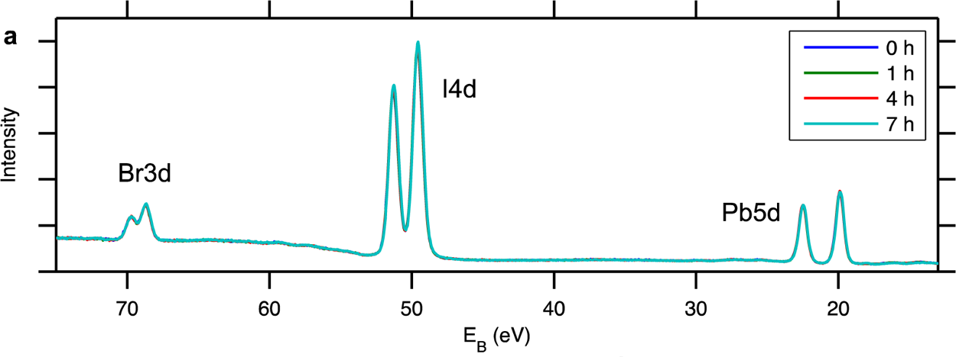

PES measurements with laser illumination
Dynamics
Property | Facility | Technique
EFFICIENT DETECTION | UBjL @ Bessy 2 | PES using ArTOF – LowDose-measurements, ps time resolution
Mårtensson, Svensson
X-rays and pump laser on same spot on sample
Measure spectra using X-rays
Follow changes induced by laser
515 nm at 1 sun

Slide 25
Following moving atoms/charges Light induced changes
Dynamics
Property | Facility | Technique
EFFICIENT DETECTION | UBjL @ Bessy 2 | PES using ArTOF – LowDose-measurements, ps time resolution
35 min
Pb²⁺
(FAPbI₃ )_{0.85} (MAPbBr₃ )_{0.15}
Pb⁰
Notes:
For photoinduced measurements, the laser system installed at the
beamline (Tangerine model from the company Amplitude Systemes)
was used at its second harmonic (515 nm), a pulse length of about 350
fs, and a repetition frequency of 208.33 kHz (i.e., 1/6 of the repetition
rate of the synchrotron pulses).
Sample environment
X-FEL (Non linear physics)
and MAXIV
1-10-100 K Wueo developments
Source, detection AND sample environment
KeysTIME AND RESLOUTION FROMSOURCES, EFFICIENT DETECTION AND RESOLUTION FROM THE DETECCTORS.
CLEVER ENVIRONMENT TO MEASURE ON RELEVENT SAMPELS . EVERY THING HAS TO BE DEVELOP.
The building of thes machins is to perform SCIENCE.

Slide 26
Energy shift, intensity changes and metallic lead
Dynamics
Intensity (normalised)
Intensity Pb⁰ (%)
on
off
on
off
Time (minutes)
Time (minutes)
Br⁻
Pb⁰
ΔE (eV)
I⁻
h⁺
h⁺
e⁻
e⁻
on
off
(FAPbI₃ )_{0.85} (MAPbBr₃ )_{0.15}
Time (minutes)

Slide 27
Energy shift, intensity changes and metallic lead
Dynamics
Intensity (normalised)
on
off
Time (minutes)
FA_{x}MA_{1-x}Pb(I_{1-x}Br_{x})₃
Multi cation (K⁺, Cs⁺, MA⁺, FA⁺) mixed perovskite

Slide 28
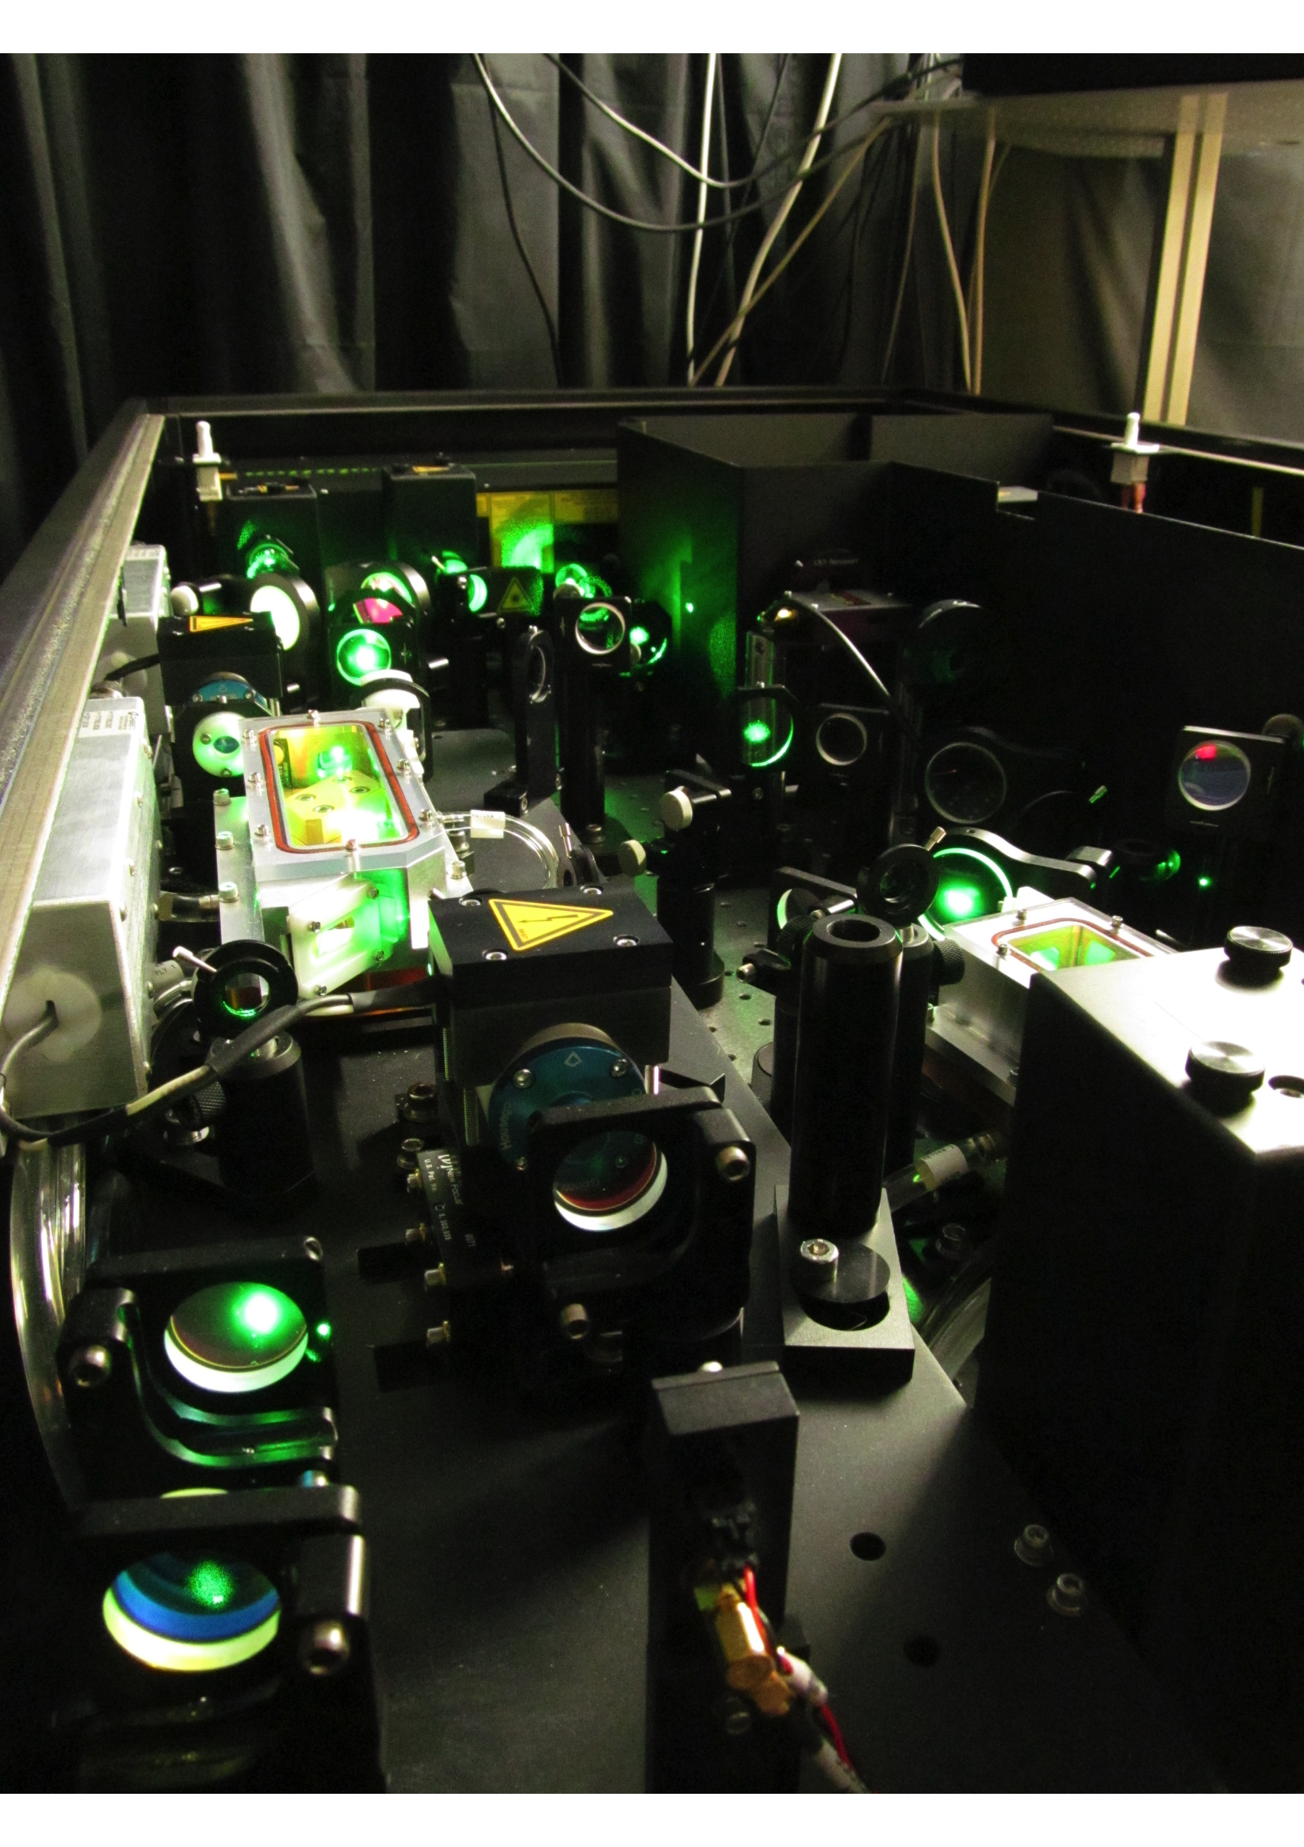
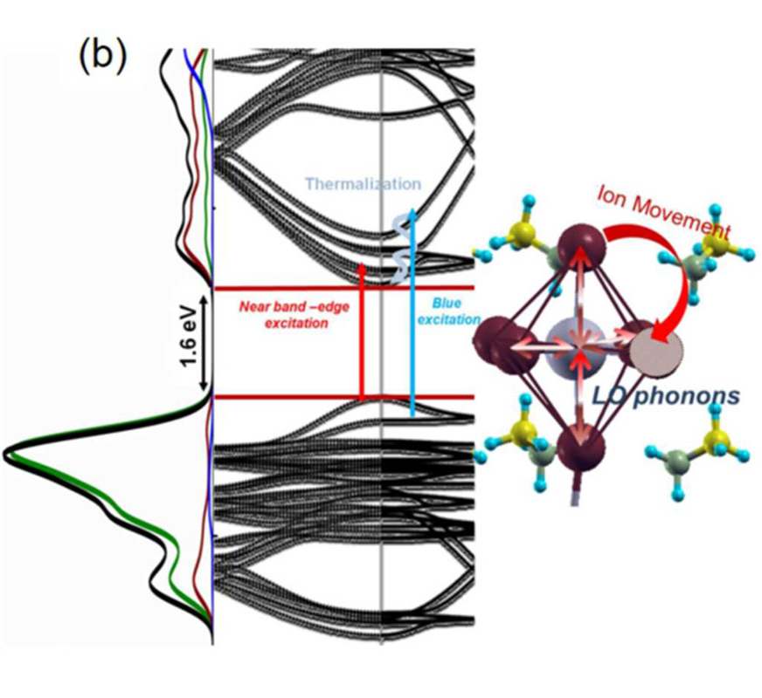
Following moving electrons
Dynamics
Property | Facility | Technique
TIME RESOLVED | HELIOS (HHG @ UU) | 50 fs, 20-70 eV, time-resolved PES and bandmapping
How can one control thermalisation ?
Cappel et al. PCCP, 2016, 18 21921-21929
Notes:
Sample environment
X-FEL (Non linear physics)
and MAXIV
1-10-100 K Wueo developments
Source, detection AND sample environment
KeysTIME AND RESLOUTION FROMSOURCES, EFFICIENT DETECTION AND RESOLUTION FROM THE DETECCTORS.
CLEVER ENVIRONMENT TO MEASURE ON RELEVENT SAMPELS . EVERY THING HAS TO BE DEVELOP.
The building of thes machins is to perform SCIENCE.

Slide 29
Time-resolved photoelectron spectroscopy
Dynamics
XUV Probe
With pump
LUMO
VIS
Kinetic Energy
Without pump
Pump
HOMO
.
Ute Cappel, Johan Söderström, Torsten Leitner et al.
Ovsyannikov, R. et al., J. Electron Spectros. Relat. Phenomena 191, 92–103 (2013)l.
Terschlüsen, J. A. et al., Nucl. Instrum. Methods Phys. Res., Sect. A 768, 84–88 (2014).
Notes:
To determine the time zero overlap of the probe and pump at the sample and the full width half maximum of the overlap, side bands were measured on helium gas.²³ Say that this was only for 800 nm and that FWHM was determined to be 52 fs +- ? here?
39 eV.

Slide 30
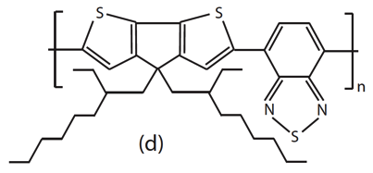
First results
Dynamics
PCPDTBT

Slide 31
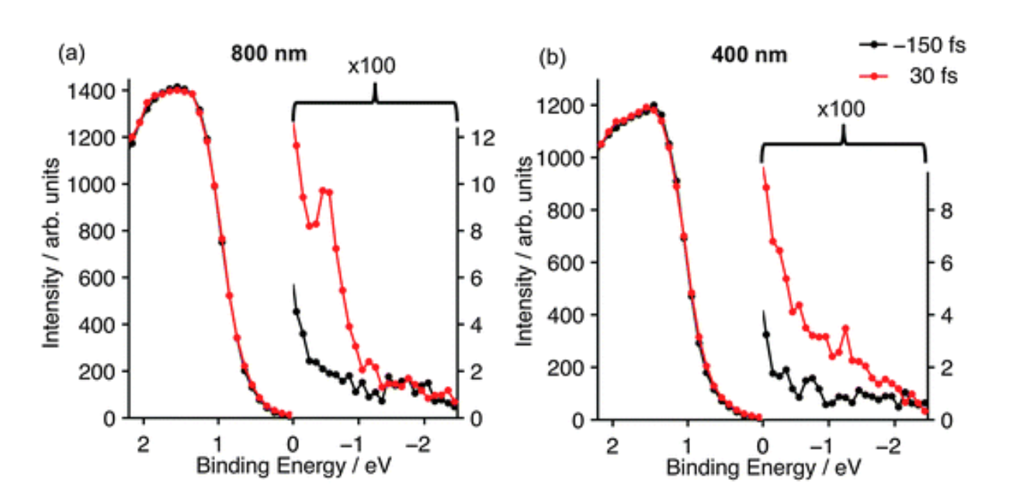
Dynamics

Slide 32
First results
Dynamics
800 nm
400 nm
- 60 fs
- 60 fs
0 fs
0 fs
60 fs
60 fs
120 fs
120 fs
270 fs
270 fs
1000 fs
1000 fs
4000 fs
4000 fs

Slide 33
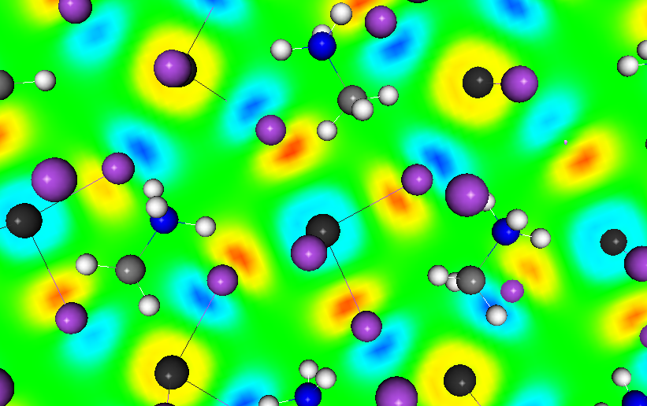
Example on atomic level understanding
Next generation – perovskite solar cells
Interface structure
Orbital
composition
Energy matching
Dynamics
Notes:
Mother compand is this
Methyl amonium lead Iodied.
Have done similar investigation. Loking simply at the bulk contributions – and then understanding changes in stochiometry in interfacial structures.
Enegy match, learn how to change the controll the absorbtion, coller of the materials and how the energy levels change and in the and match the sunstrat or elekton transporting layer.
Som experimental ide of how the electon look like HOMO beeing an I p antibonding character. Wy this materials is non sensitive to DEFECT STATES.

Slide 34
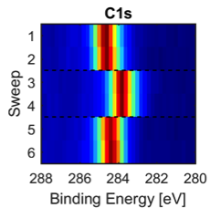
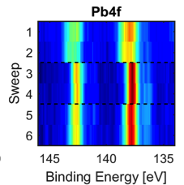
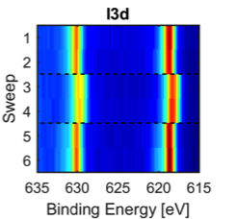
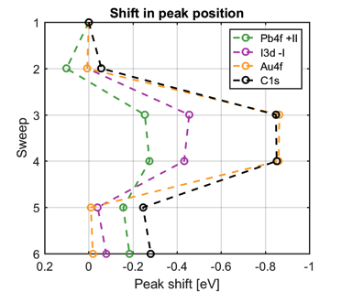
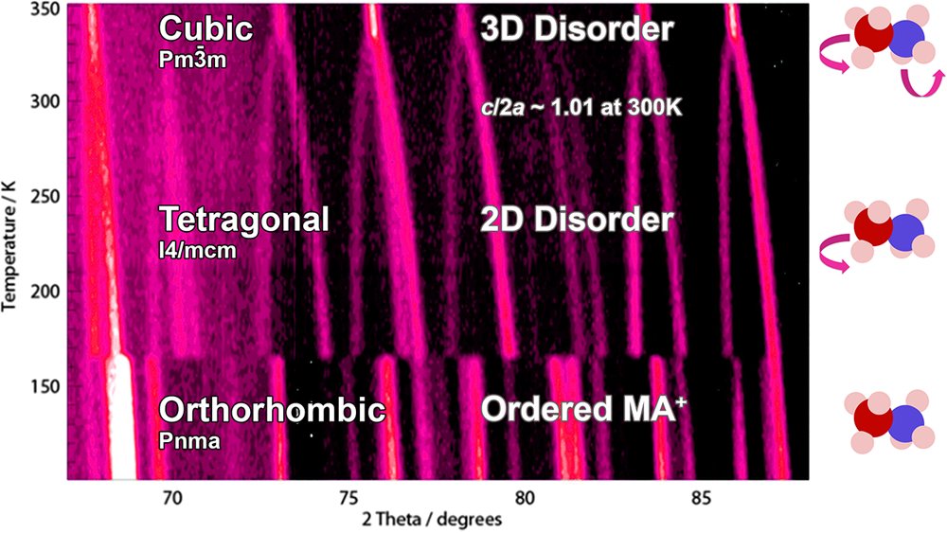
Following atoms/charges
Voltage induced changes
Example 3
Property | Facility | Technique
ENVIRONMENTS I | HAXPES @ BESSY, SOLEIL, DIAMOND, DESY | Real interfaces during operation
The hard X-ray allow penetration
through the interface
How is the electric field distributed, what is the role of the electrons/atoms.
Notes:
Thin fiml solar cell configuration
EHL sam shift.
Perovskit has a smaller shift and interestingly the constituents in the perovskit shift differently.

Slide 35
X-ray based methodology
Our main current development projects
Property | Facility | Technique
TIME RESOLVED | HELIOS (HHG @ UU) | 50 fs, 20-70 eV, time-resolved PES and bandmapping
EFFICIENT DETECTION | UBjL @ Bessy 2 | PES using ArTOF – LowDose-measurements, ps time resolution
ENVIRONMENTS I | HAXPES @ BESSY, SOLEIL, DIAMOND, DESY | PES on real buried interfaces during operations. Surface bulk. PDOS.
ENVIRONMENTS II | SPECIES, HIPPIE @ MAX IV | High pressure PES, RIXS on the Li edge
HIGH RESOLUTION | VERITAS @ MAX IV | RIXS > 30 K resolving power
(EL.) STRUCTURE | DIFFMAX/HAXPES | Structure and electronic structure in operation
All multi million developments – The energy research very important in the scientific cases
Notes:
New opportunities –developed by us may role is to meke design so we can anserr question linked the the energy research
.

Slide 36
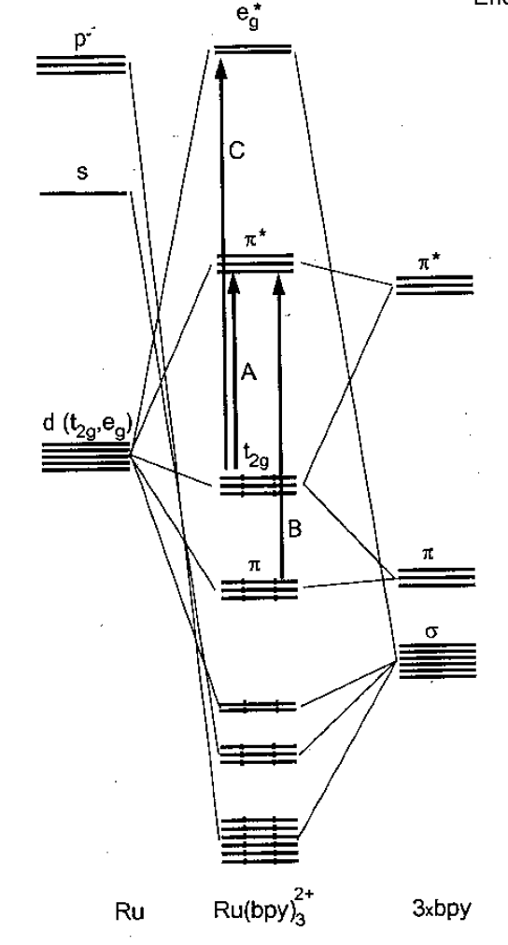
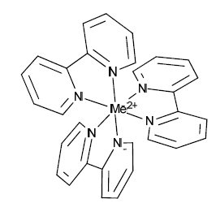
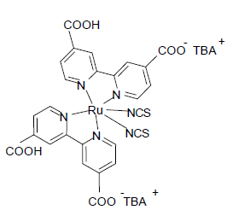
Ru-complexes a molecular example
Orbital
composition
About 50%
Partial DOS of Ru 4d

Slide 37
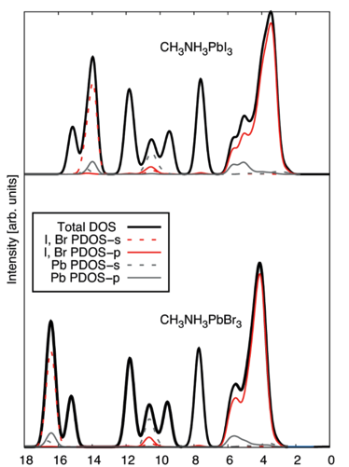
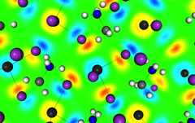
Perovskite
VB Character
Orbital
composition
Pb6s-Br4p
Notes:
CANNOT SEE Sigma star Pb6s-I5p
MAINLY BR/I P ORBITALS
6 versus 2 electrons
C1s 758 0.077 1487 0.013 8000 ev 0.00008
C2p 0.0022 0.00024 0.00000038
Lead 0.0019 0.00061 0.000035
2.2.2 unit cell DFT DFT Odelius
In our calculation, we have employed
a 2 Å~ 2 Å~ 2 supercell, with approximate dimensions 17 Å~ 17 Å~
25 Å, containing 32 Pb2+ , 96 I− /Br− , and 32 CH3 NH3
+ ions.
The geometries of both the perovskite structures were
optimized i

Slide 38
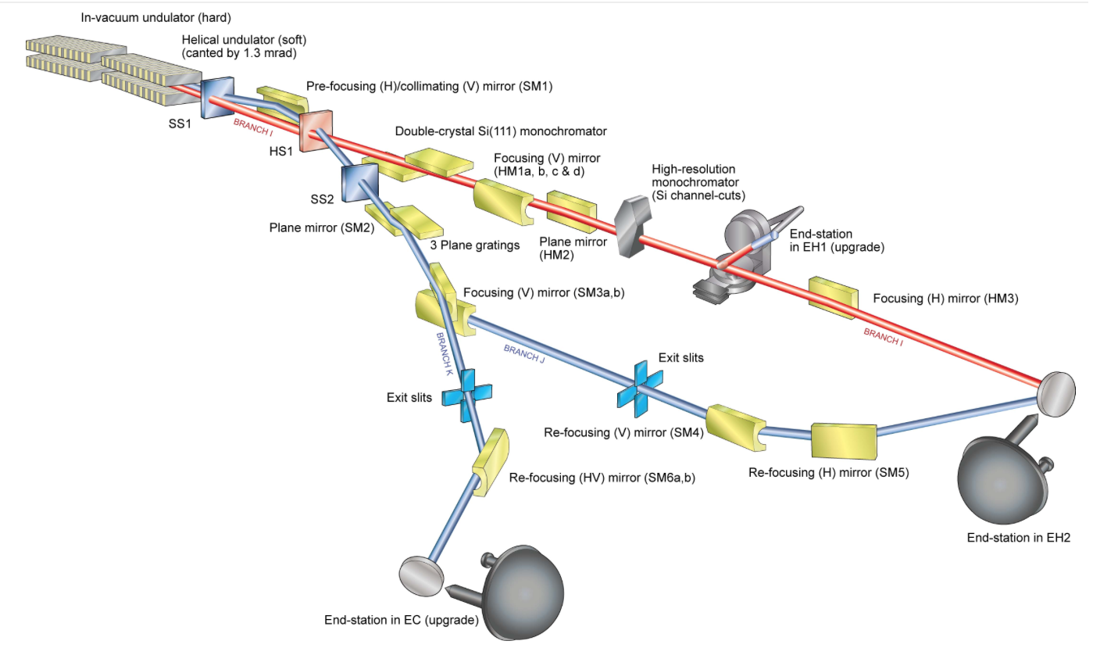
Future - Foundation
X-ray based methodology
Our main current development projects
Property | Facility | Technique
ENVIRONMENTS I | HAXPES @ BESSY, SOLEIL, DIAMOND, DESY | PES on real buried interfaces during operations. Surface bulk. PDOS.
Hard 2300-18000 eV
Soft 230-800 eV
Notes:
New opportunities –developed by us may role is to meke design so we can anserr question linked the the energy research
.

Slide 39
Ru-complexes a molecular example
PDOS
Orbital
composition
Multilayer
C2p (N,O)‏
Mainly Ru4d
BL 51, BLI 411 and KMC1/BESSY
Partial DOS of Ru 4d

Slide 40


Interface structure
FA_{x}MA_{1-x}Pb(I_{1-x}Br_{x})₃
Investigation of a mixed perovskie (FA_{0.85}MA_{0.15}Pb(I_{0.85}Br_{0.15})₃)
-10% PbI₂
Stoichiometric (0%)
(c) +10% PbI₂
I/Pb ratio of 2.55 is expected
hν = 4000 eV
I4d
+10%
0%
-10%
PbI₂
I4d_{5/2}
Pb5d
I4d_{3/2}
Br3d
Binding Energy (eV)
Binding Energy (eV)
Use of three energies
i.e.
three analysis depths
Validation of the quantification process with a reference
Jacobsson et al. JACS 2016, 138, 10331−10343
Notes:
MOrphology

Slide 41
X-ray based methodology
Our main current development projects
Property | Facility | Technique
TIME RESOLVED | HELIOS (HHG @ UU) | 50 fs, 20-70 eV, time-resolved PES and bandmapping
EFFICIENT DETECTION | UBjL @ Bessy 2 | PES using ArTOF – LowDose-measurements, ps time resolution
ENVIRONMENTS I | HAXPES @ BESSY, SOLEIL, DIAMOND, DESY | PES on real buried interfaces during operations. Surface bulk. PDOS.
ENVIRONMENTS II | SPECIES, HIPPIE @ MAX IV | High pressure PES, RIXS on the Li edge
HIGH RESOLUTION | VERITAS @ MAX IV | RIXS > 30 K resolving power
All multi million developments – The energy research very important in the scientific cases
Notes:
New opportunities –developed by us may role is to meke design so we can anserr question linked the the energy research
.

Slide 42



Electrode-solvent interface
Energy matching
Property | Facility | Technique
ENVIRONMENTS II | SPECIES, HIPPIE @ MAX IV | High pressure PES, RIXS on the Li edge
HP-HAXPES at ALS
New feature appearing in O1s spectra due to adsorbed water!
4000 eV
Kaufman-Eriksson et al. Top Catal (2016) 59:583–590 DOI 10.1007/s11244-015-0533-3
BL 9.3.1 ALS (SCIENTA HiPP-2)
Notes:
beamline 9.3.1 of the Advanced Light Source (ALS) at Lawrence Berkeley National Laboratory [30]. The end-station is equipped with a Scienta R4000 HiPP-2 spectromete
HIPPIE upp to 200o eV
Susanna K. Eriksson,† Maria Hahlin,,‡ Stephanus Axnanda,¶ Ethan Crumlin,¶
Regan Wilks,§ Anna I. K. Eriksson,† Zhi Liu,¶ John Åhlund,k Anders Hagfeldt,†
Hans Siegbahn,‡ David E. Starr,§ Marcus Bär,§ and Håkan Rensmo,‡
Department of Chemistry-Ångström, Uppsala University, Box 523, SE-751 20 Uppsala, Sweden,
Department of Physics and Astronomy, Uppsala University, Box 516, SE-751 20 Uppsala,
Sweden, Advanced Light Source Division and Material Science Division, Lawrence Berkeley
National Laboratory, Berkeley, California 94720, U.S.A, Solar Energy Research,
Helmholtz-Zentrum Berlin für Materialien und Energie GmbH (HZB), D-14109 Berlin, Germany,
and VG Scienta AB, Box 15120, SE-750 15 Uppsala, Sweden

Slide 43


Electrode-solvent interface
Energy matching
Property | Facility | Technique
ENVIRONMENTS II | SPECIES, HIPPIE @ MAX IV | High pressure PES, RIXS on the Li edge
S1s
0.2 eV shift
0.2 eV shift
HOMO
Notes:
Mm

