Slide 1
Normal Conducting magnets for particle accelerators
Part I
A. Vorozhtsov

Slide 2
Magnet types by working principle
Superconducting Magnets. They work only at very low temperatures (liquid or superfluid helium). The high current density possible in their special cables produces a high magnetic field not possible with resistive magnets.
Permanent Magnets. No current flows into these magnets. The field is produced by means of the permanent residual magnetization of special materials. This technology allows the construction of compact magnets with a relatively strong field. No cooling is required.
Normal conducting. They are not magnetic unless a certain current flows into their coils. The field can be increased and concentrated by means of a ferromagnetic yoke. The resistance of the windings dissipates some energy and the resulting heat has to be removed with a water circuit or air flow

Slide 3
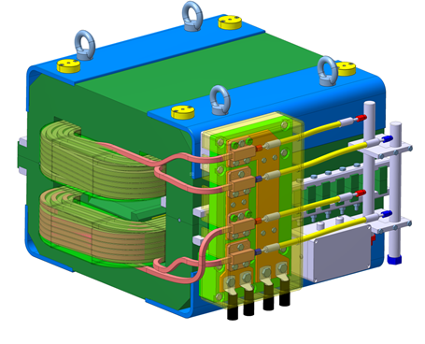
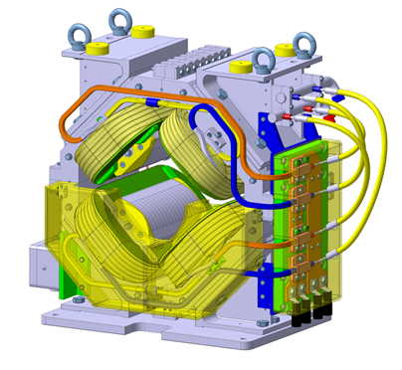
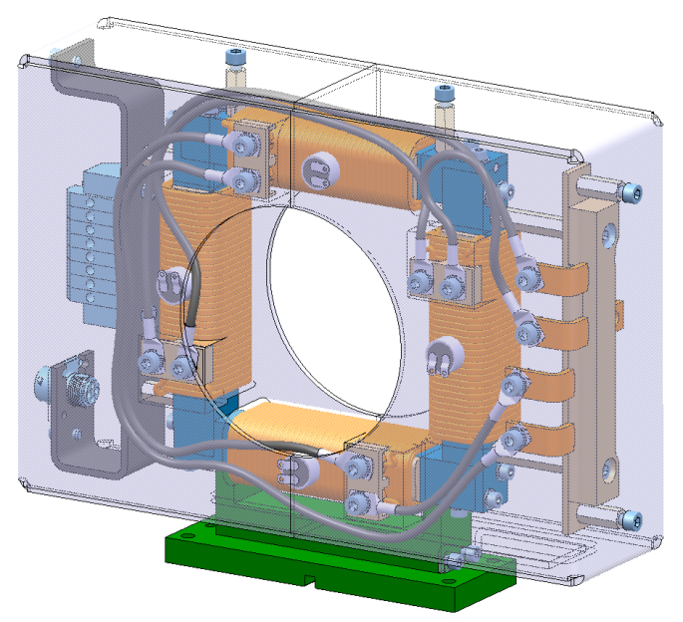
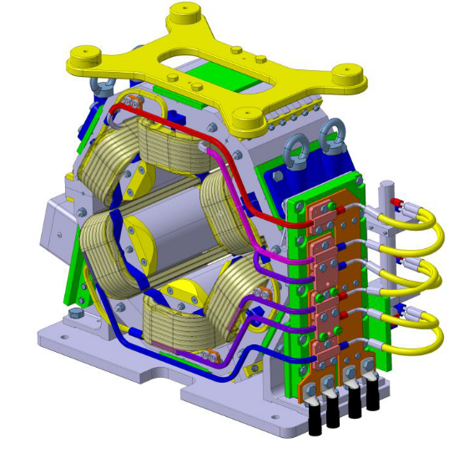
Main components of normal-conducting, iron dominated magnets
Iron ( Pole + Return Yoke)
Excitation Coils
Sensors
Cooling circuits (for water cooled coils, manifold)
Electrical connections
Supports
Alignment target holders
Dipole
Quadrupole
H/V corrector
sextupole

Slide 4
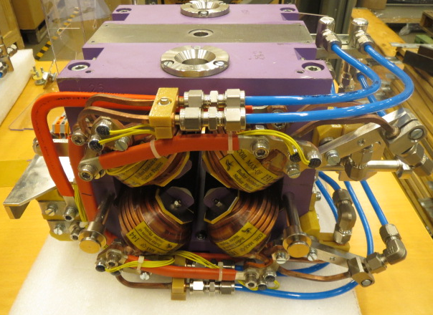
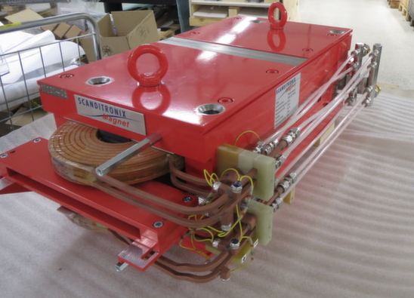
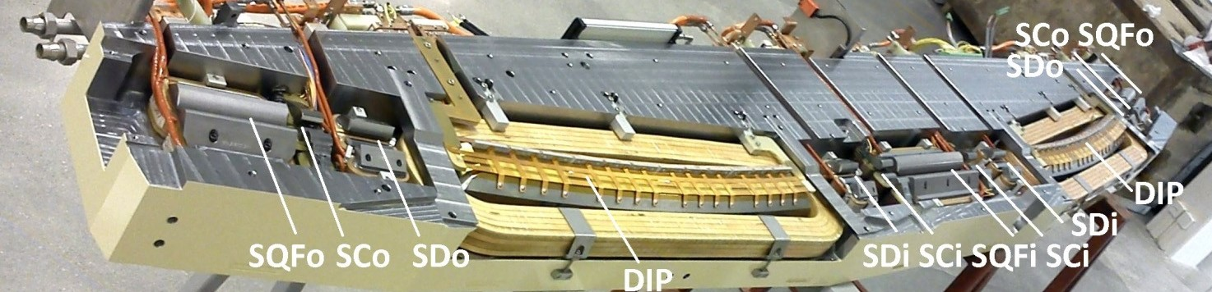
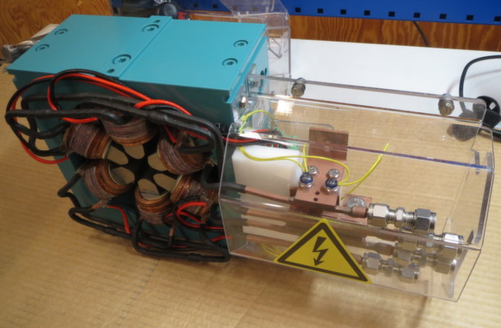
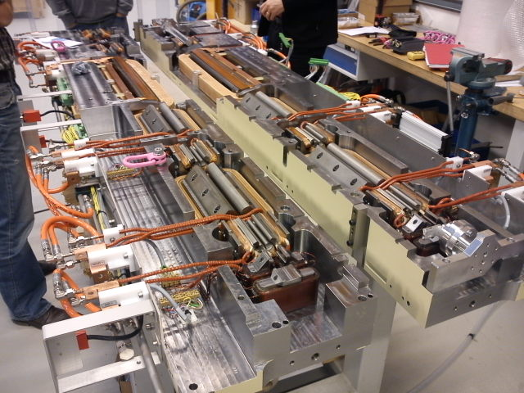
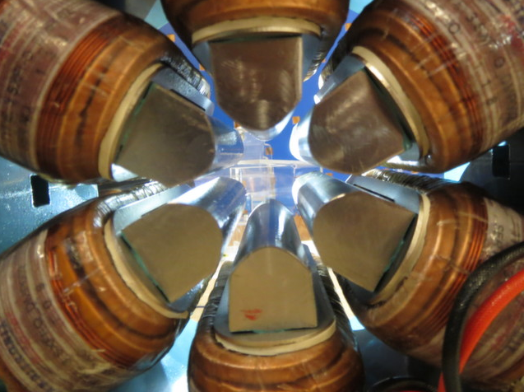
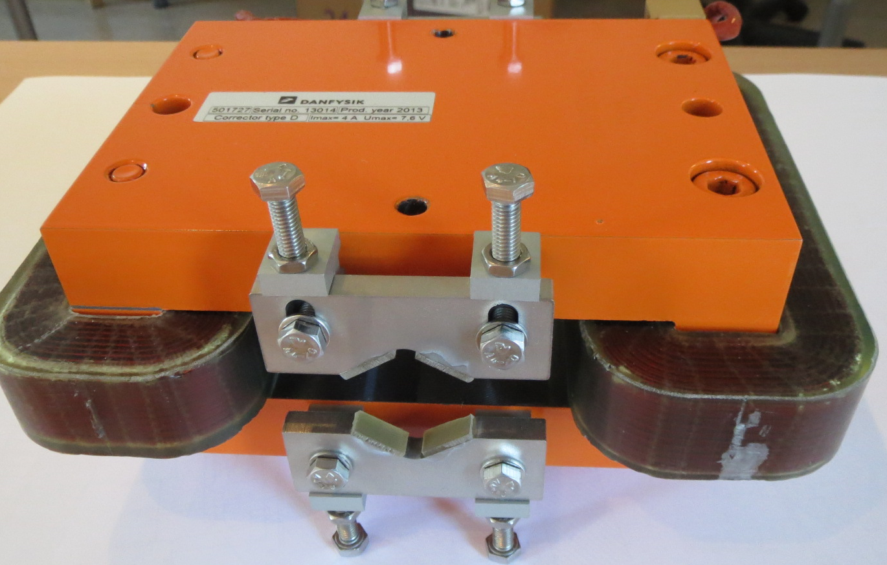
MAX IV Magnets
MAX IV LINAC DIPOLE magnet DIB
MAX IV LINAC quadrupole QF
MAX IV R1 magnet block
MAX IV sextupole SXH
MAX IV LINAC one plane corrector COD
MAX IV R3 magnet block

Slide 5
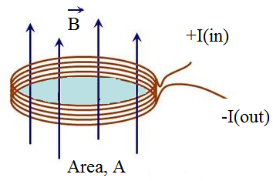
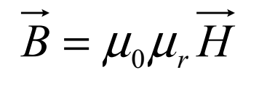
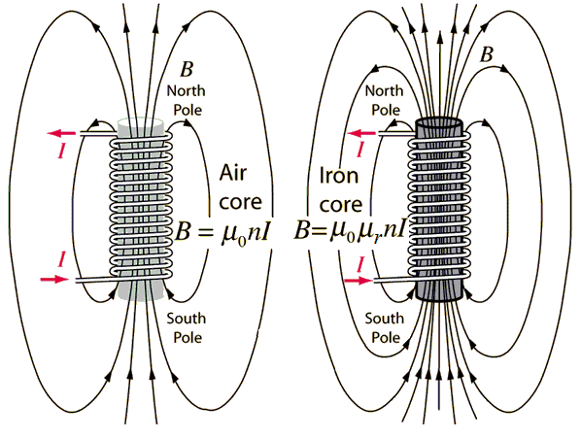
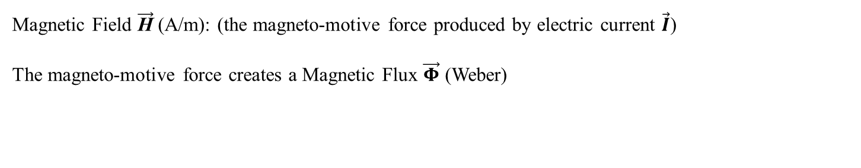
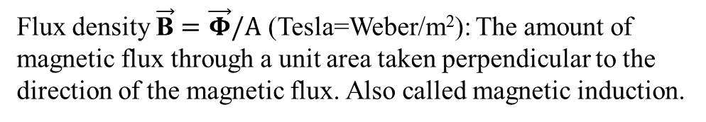
Nomenclature
Magnetic Field $\vec{\text{H}}$ (A/m): (the magneto-motive force produced by electric current $\vec{I}$)
The magneto-motive force creates a Magnetic Flux $\vec{Φ}$ (Weber)
Flux density $\vec{\text{B}}=\vec{Φ}/A$ (Tesla=Weber/m²): The amount of magnetic flux through a unit area taken perpendicular to the direction of the magnetic flux. Also called magnetic induction.
Permeability of free space: µ₀ = 4π×10⁻⁷ (H/m)
Relative permeability: µ_{r}=µ / µ₀ (dimensionless)
µ_{r} (free space)=1, µ_{r} (Iron) ≈1000

Slide 6
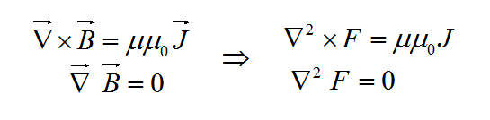
MAGNETO-STATIC THEORY
Maxwell’s Steady State
Magnet Equations
Poisson’s Equation
Laplace’s Equation
F is a function of the two dimensional complex space coordinate z=x+iy is developed from Maxwell’s equations. This function satisfies Laplace’s and Poisson’s equations.
This function is used to describe different two dimensional magnetic fields and their error terms.

Slide 7
Vector and Scalar Potentials
The function can be expressed as F=A+iV where
  A, the vector potential is the real component
  V, the scalar potential V is the imaginary component
An ideal pole contour can be computed using the scalar equipotential.
The field shape can be computed using the vector equipotential.

Slide 8
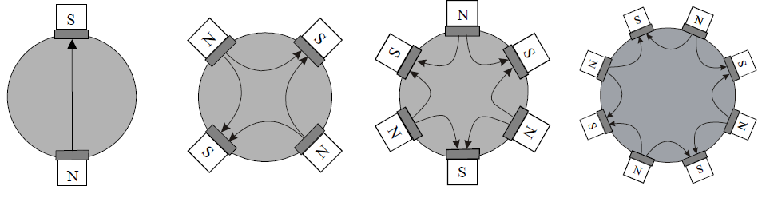
Two dimensional magnetic field
The gaps are regions where current sources and permeable material are absent. Two-dimensional magnet fields can be derived from potential functions which are the solutions to Laplace’s equation.
In Cartesian coordinates, the components are given by:
B_{x} = B_{r} cos θ - B_{θ} sin θ
B_{y} = B_{r} sin θ + B_{θ} cos θ
A_{n} and B_{n} are the skew and normal field components
n-field index: Dipole n=1 , Quadrupole n=2, Sextupole n=3, Octupole n=4

Slide 9
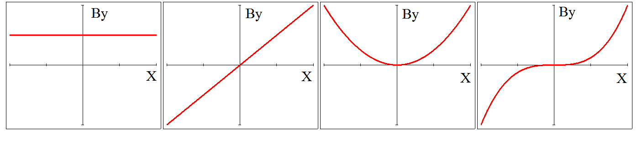
Magnet types by their field
For normal(non-skew) the expansion of B_{y}(x) _{y = 0} is a Taylor series:
B_{y}(x) = _{∑n =1} ∞ {b_{n} x ^{(n-1)}} = b₁ + b₂x + b₃x² + b₄x³ …..
dipole quad sextupole octupole

Slide 10
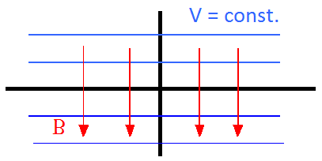
Ideal pole shape
Flux is normal to a ferromagnetic surface with infinite μ:
curl H = 0
therefore ∫ H.ds = 0;
in steel H = 0;
therefore parallel H air = 0
therefore B is normal to surface.
μ = ∞
μ = 1
Flux is normal to lines of scalar potential, (B = - ∇φ);
So the lines of scalar potential are the perfect pole shapes!
dipole
quadrupole
(but these are infinitely long!)

Slide 11
The Practical Pole
Practically, poles are finite, introducing errors;
these appear as higher harmonics which degrade the field distribution.
However, the iron geometries have certain symmetries that restrict the nature of these errors.
Dipole:
Quadrupole:

Slide 12
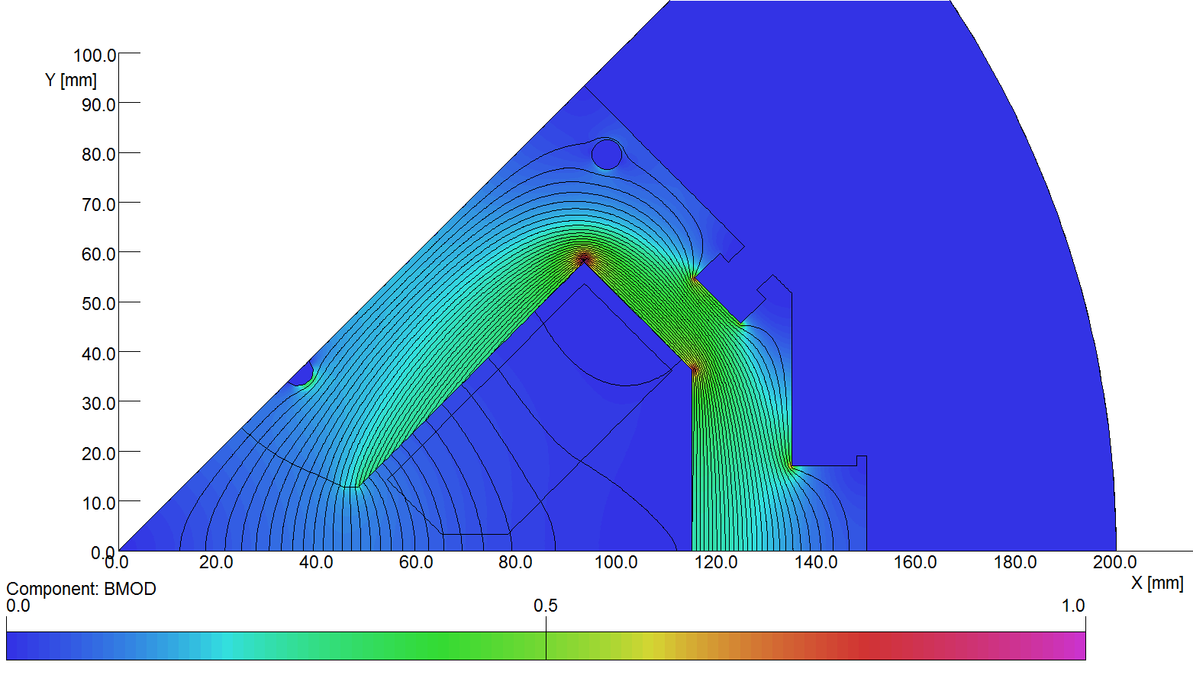
Shims
The ‘shim’ is a small, additional piece of ferromagnetic material added on each side of the poles – it compensates for the finite cut-off of the pole to reduce “allowed” harmonics
  For the dipole, N=1, the allowed error multipoles are n=3, 5, 7, 9, 11, 13, 15, …
  For the quadrupole, N=2, the allowed error multipoles are n=6, 10, 14, 18, 22, …
N
S
Shims

Slide 13
Normal Bn and Skew An Magnets
Normal quadrupole
Skew quadrupole
Rotation by 45 degrees
Skew sextupole
Normal sextupole
Rotation by 30 degrees

Slide 14
Introduction of currents (Ampere’s law)
Now for j ≠ 0 ∇ × H = j ;
To expand, use Stoke’s Theorem:
for any vector V and a closed curve s :
∫V.ds =∫∫ curl V.dS
Apply this to: curl H = j ;
then in a magnetic circuit:
∫ H.ds = N I;
N I (Ampere-turns) is total current cutting S

Slide 15
Magnet types
Dipoles
Quadrupoles
Sextupoles
Octupoles
Combined function

Slide 16
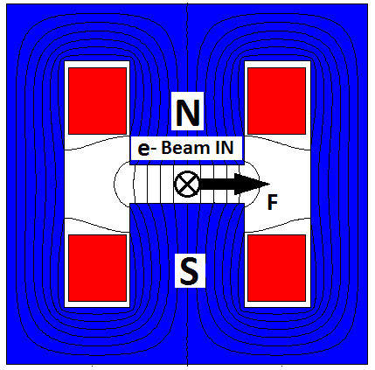
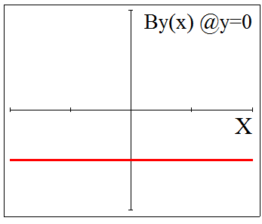
DIPOLE MAGNET
Function: to bend or steer the particle beam
Equation for normal (non‐skew) ideal (infinite) poles: y=±r (r = half gap height)
Fundamental field index N=1
Magnetic flux density in the air gap: By= B1 = const.
Finite poles introduce ‘Allowed’ harmonics : n = 3, 5, 7, ...

Slide 17
DIPOLE MAGNET (YOKE SHAPES)
N
N
N
S
S
S
“C core”:
Advantages:
Easy access;
Classic design;
Low A-Turns;
Disadvantages:
Less rigid;
Needs shims;
Asymmetric.
“H core”:
Advantages:
Symmetric;
More rigid;
Low A-Turns
Disadvantages:
Needs shims;
Access problems.
''Window Frame”
Advantages:
No pole shim;
Symmetric & rigid;
Disadvantages:
High A-Turns
Major access problems;
Insulation thickness

Slide 18
DIPOLE MAGNET (EXCITATION)
Ampere’s law:
Along Path 1
Along path 2
For iron;
Along path 3:
and
Ampere-turns per pole(for all multipoles)
r- aperture radius, n-field index
Finally:
Ampere-turns per pole(dipole), where h- half gap;

Slide 19
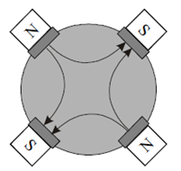
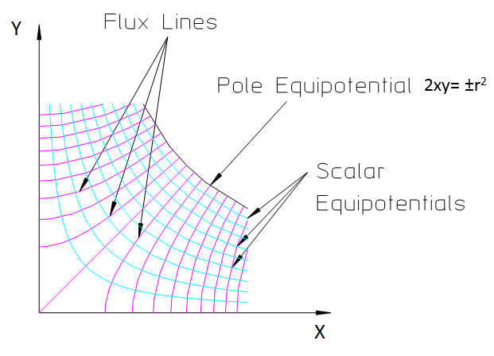
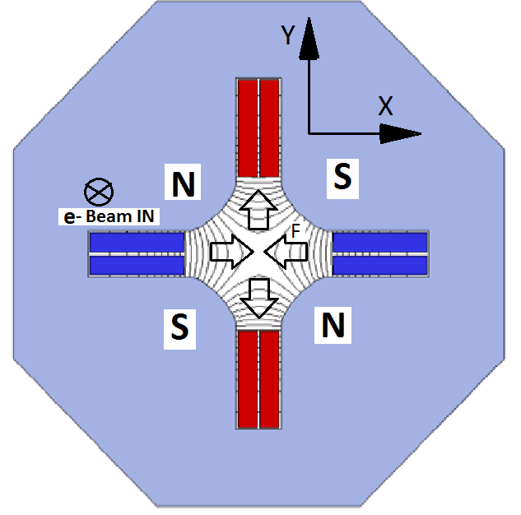
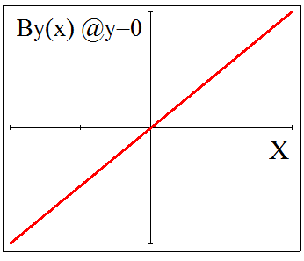
QUADRUPOLE MAGNET
Function: focusing the beam (horizontally focused beam is vertically defocused)
Equation for normal (non‐skew) ideal (infinite) poles: 2xy= ±r² (r - aperture radius)
Fundamental field index N=2
Magnetic flux density : By= B₂·x
Finite poles introduce ‘Allowed’ harmonics : n = 6, 10, 14, ...

Slide 20
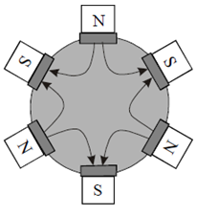
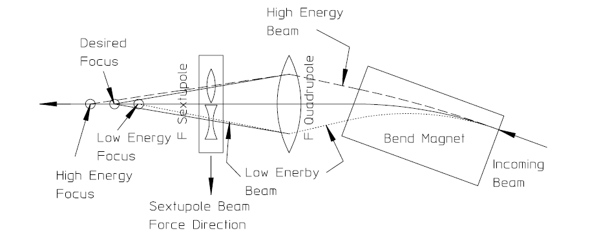
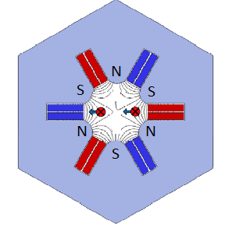
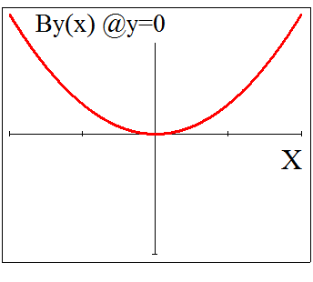
SEXTUPOLE MAGNET
Function: to affect the beam at the edges, much like an optical lens which corrects chromatic aberration.
Equation for normal (non‐skew) ideal (infinite) poles: 3x²y ‐y³= ±r³ (r - aperture radius)
Fundamental field index N=3
Magnetic flux density: By= B₃·(x²+y²)
Finite poles introduce ‘Allowed’ harmonics : n = 9, 15, 21, ...

Slide 21
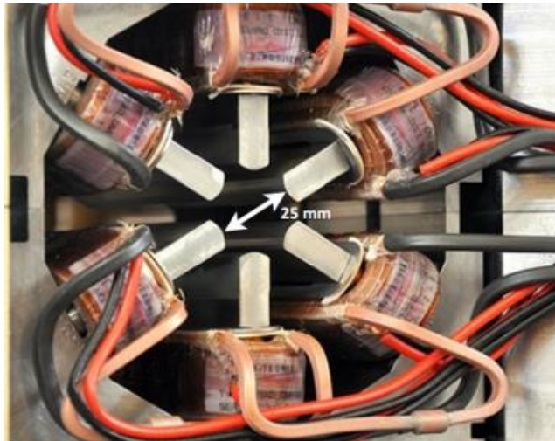
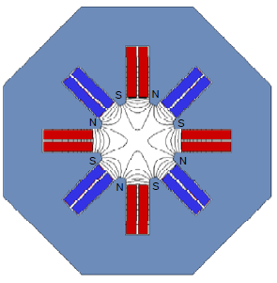
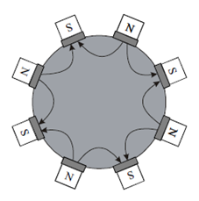
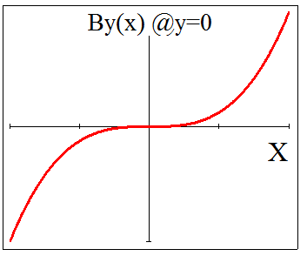
OCTUPOLE MAGNET
Function: Octupole field induces ‘Landau damping’ :
introduces tune-spread as a function of oscillation amplitude;
de-coheres the oscillations;
reduces coupling.
Equation for normal (non‐skew) ideal (infinite) poles: 4(x³y –xy³) = ±r⁴ (r - aperture radius)
Fundamental field index N=4
Magnetic flux density: By= B₄·(x³-3xy²)
Finite poles introduce ‘Allowed’ harmonics : n = 4, 12, 20, ...

Slide 22
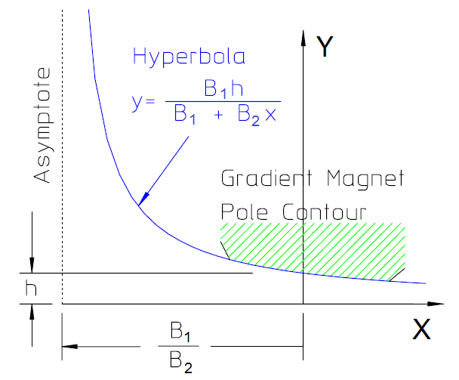
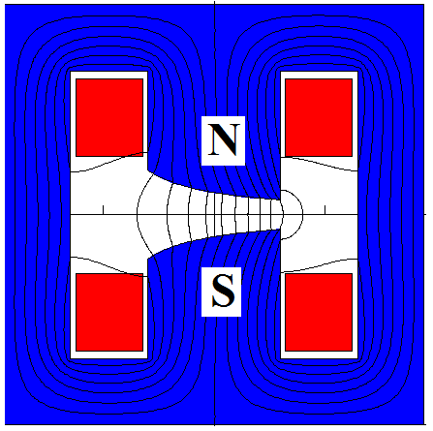
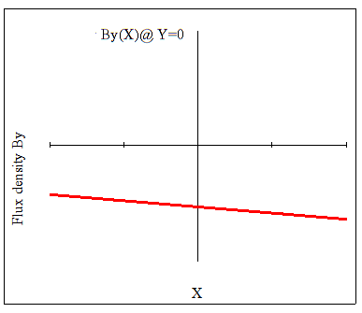
COMBINED FUNCTION MAGNET (Gradient dipole)
Function: specialized dipole magnet which in addition to a bend field at its center has a linear gradient. This magnet is a combined function magnet which simultaneously focuses (or defocuses) and bends the beam.
Equation for normal (non‐skew) ideal (infinite) poles: 4(x³y –xy³) = ±r⁴ (r - aperture radius)
Fundamental field index N=1 and 2
Magnetic flux density: By= B₁+B₂·x

Slide 23
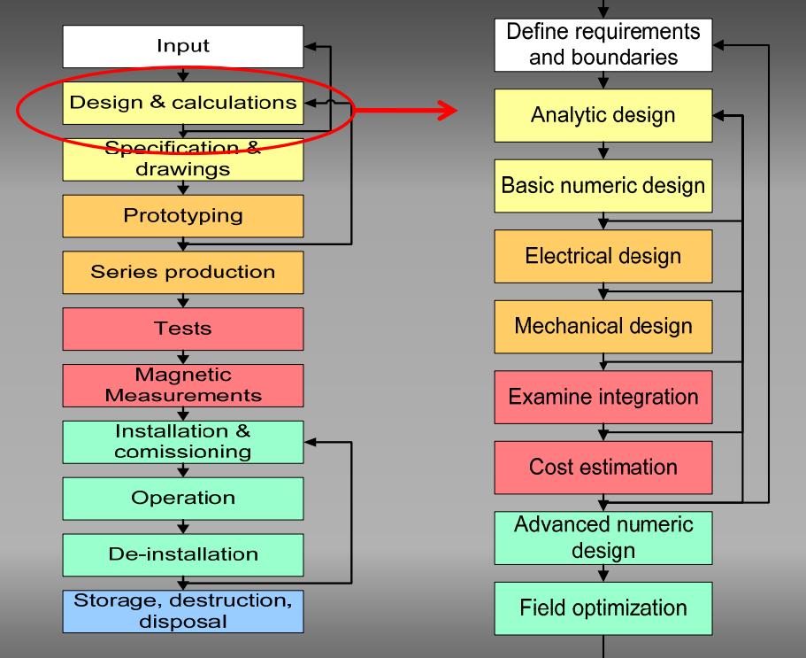
Magnet live cycle

Slide 24
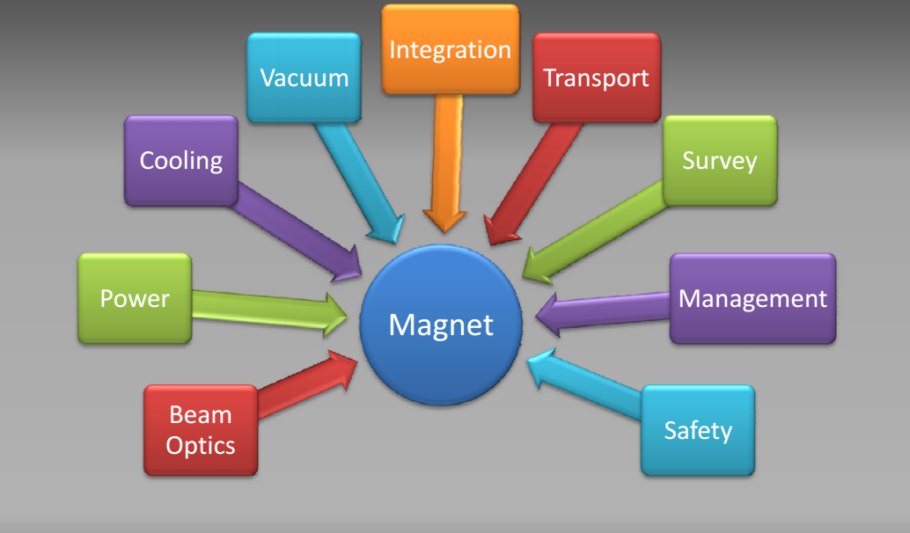
Input

Slide 25
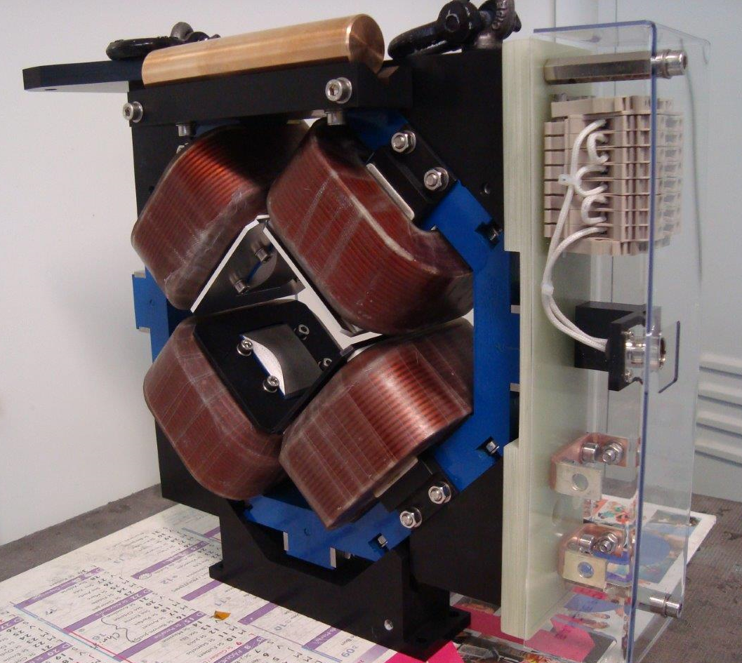
An example of a magnet follow-up: quadrupole
definition of the specifications (requirements and constrains)
EM / preliminary mechanical design
mechanical design
technical specifications & procurement
acceptance (reception tests & magnetic measurements)
Units to be produced | 11 + (1) | Installed + (spare)
Electron beam energy range | 10 – 20 | MeV
Full aperture Ø | ≥ 70 | mm
Integrated field gradient range | 0.01(10% margin) – 0.18(20% margin) | T
Effective length | 70 | mm
Good field region radius | 20 | mm
Integrated field gradient quality Δ∫Gdz/∫G_{(0,0,z)}dz | < ±40 | units
Operational mode | DC
Overall magnet length | ≤ 200 | mm
Overall magnet width x height | < 400 | mm
Power converter current / voltage | < 10 / < 10 | A / V

Slide 26
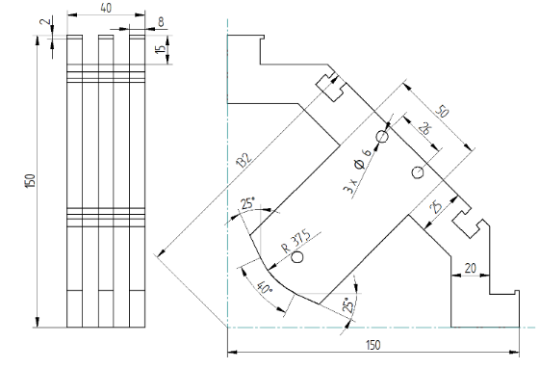
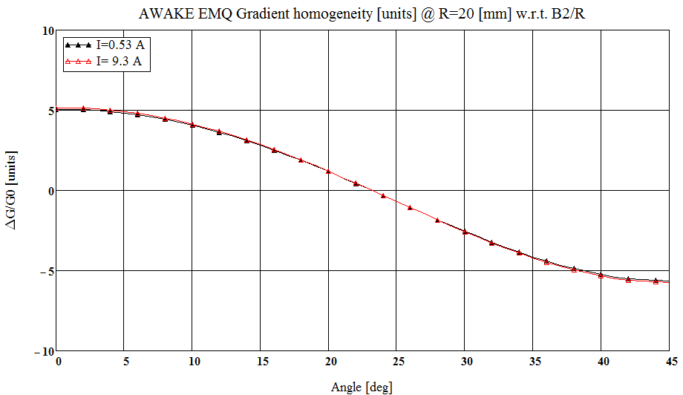
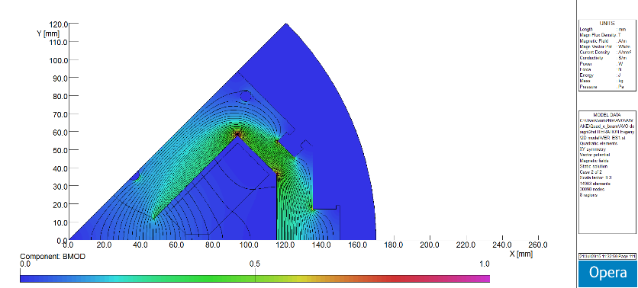
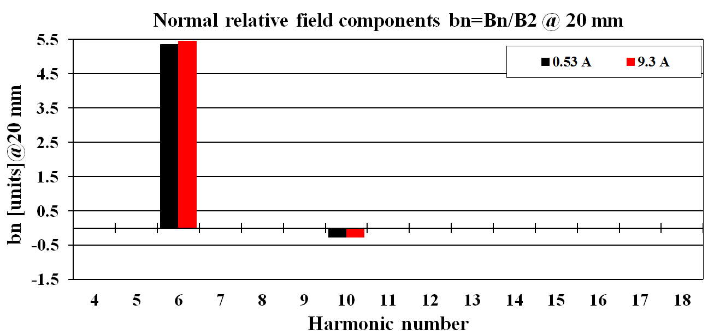
EM / preliminary mechanical design
Aperture R=35 mm, Leff=70 mm => B’(0)=(0.14 – 2.57) => NI (1),
Coil (water / air cooled)=> Copper conductor(VonRoll) => Nw/pole (Current, Voltage)
Yoke material low Hc(residual field, Bpole(min)=50 Gauss) / (solid / laminated)
Yoke length (2)
2D optimization
Pole profile optimization
Coil profile optimization
Yoke cross-section optimization
Harmonic analysis

Slide 27
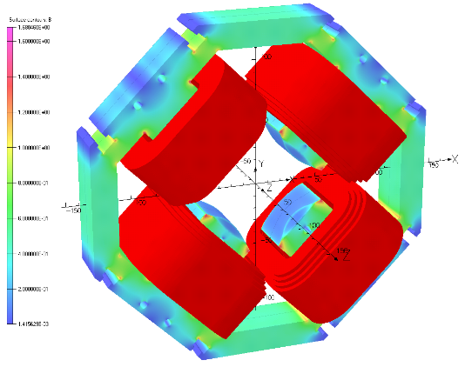
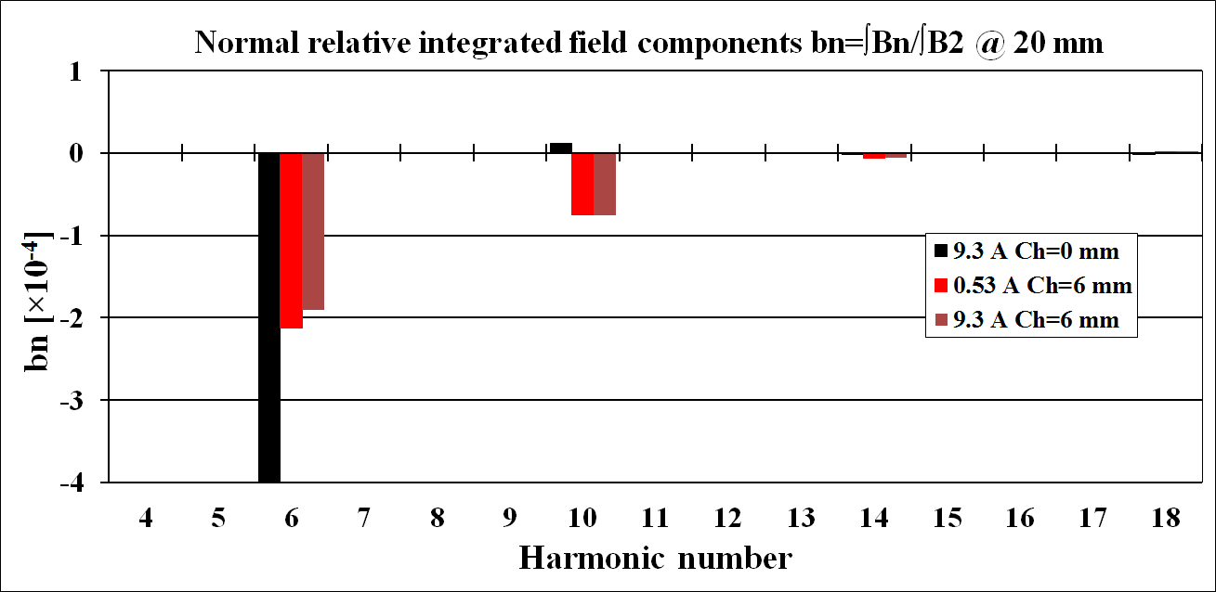
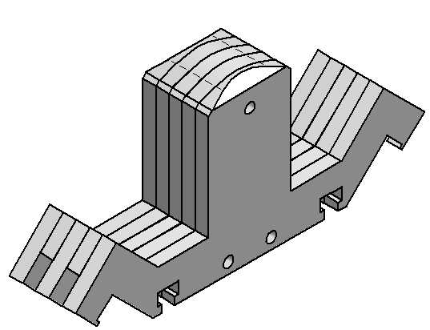
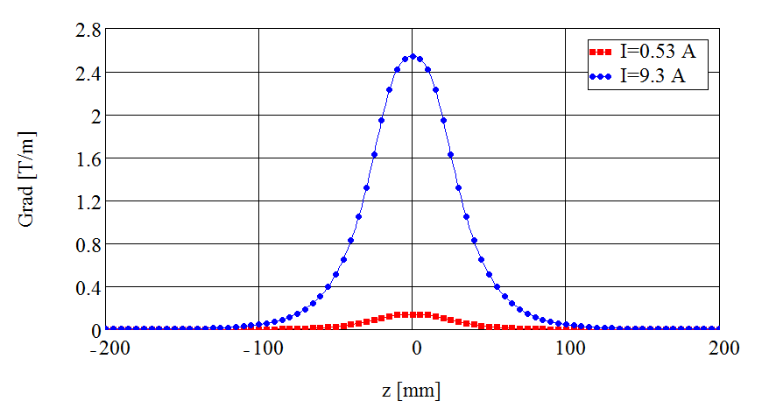
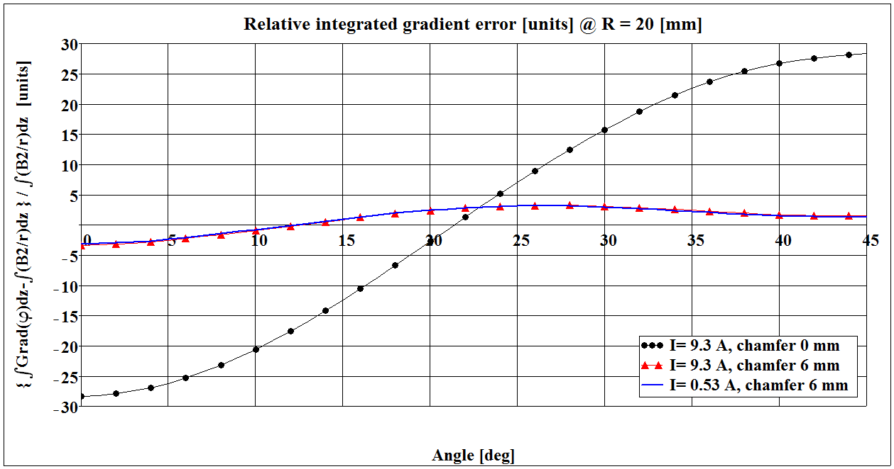
3D optimization
Integrated field
Chamfer profile optimization /Harmonic analysis
Magnetic length
Update of the electrical parameters
The relative integrated gradient errors at GFR boundary with the radius of 20 mm were calculated according to the formula:

Slide 28

An example of a magnet follow-up: Awake quadrupole
Mechanical design / Technical Specification
Main Parameters / Tolerances / 3D model (.step file) => Mechanical design => Technical Specification
Parameter | Value | Unit
BASIC
Number of magnets | 12
Nominal field gradient | 2.54 | T/m
Aperture diameter | 70 | mm
FIELD QUALITY (for information only)
Integrated field gradient range ∫Gdl | 0.01 – 0.18 | T
Magnetic length | 71.8 | mm
Good field region diameter | 40 | mm
Integrated gradient homogeneity Δ∫Gdl / ∫Gdl | < ± 5·10⁻⁴
ELECTRICAL PARAMETERS
Nominal current I_{nom} | 9.3 | A
Maximum current I_{max} | 10 | A
Current density at I_{max} | 1.2 | A/mm²
Dissipated DC power at I_{nom} | 34 | W
Resistance at 20°C | 391 | mΩ
Inductance | 48.1 | mH
Voltage on magnet U_{nom} (DC) | 3.64 | V
COOLING
Cooling method | Air, natural convection
DIMENSIONS AND WEIGHT
Yoke length | 40 | mm
Overall length | ~156 | mm
Overall width | ~395 | mm
Overall height | ~342 | mm
Total magnet mass | ~ 23 | kg
Parameter | Value | Unit
Number of coils per magnet | 4
Number of pancakes per coil | 1
Number of turns per coil | 138
Conductor length per coil | ~43 | m
Conductor size on copper | 3.0 × 2.8 | mm × mm
Conductor edge rounding radius | 0.5 | mm
Min. conductor insulation thickness | 0.06 | mm
Max. conductor size with insulation | 3.2 × 3.0 | mm × mm
Ground insulation thickness | 1.5 | mm
Electrical resistance per coil at 20°C | 98 ± 1 | mΩ

Slide 29



Production follow-up
Preliminary and Final Design Reports
Magnet and tooling drawings
Material certificates
QCR(Yoke, Coils, Magnet)
Samples

Slide 30


Production follow-up QCR
Coil

Slide 31



Production follow-up QCR

Slide 32

Production follow-up (QCR)

Slide 33
REFERENCES
Jack T. Tanabe “Iron Dominated Electromagnets” Design, Fabrication, assembly and measurements.
T. Zickler (CERN) “Basic design and engineering of normal‐conducting, iron‐dominated electro‐magnets”. CERN Accelerator School Specialized Course on Magnets. Bruges, Belgium, 16‐25 June 2009
3) Neil Marks. “Conventional magnets for Accelerators”. Lecture to Cockcroft Institute. 2005

