Slide 1
&
Mechanical Design Office

Slide 2
A presentation of Mechanical Design Office
Anders Bjermo – Karl Åhnberg - Linus Roslund
2018 10 30

Slide 3
Who are we working here?
Designers employd by Max IV:
Anders Bjermo
Karl Åhnberg
Linus Roslund
El Sayed El Afifi
Designers / consultants from Combitech:
Daniel Lundström
Jörgen Hellborg
Johan Selberg

Slide 4
SolidWorks PDM Professional The most important tool in our daily work
PDM – Product Data Management our SQL database, a file server
Keep tracks of all files we create but most it handles our CAD-files such as assemblies, models/parts & drawings
The files are secured and backed up, if they are checked in
We approve files when they are ready for production
Who created the file from the beginning, that we know
We can let anyone access the files, if they have PDM installed
Several people can look at the same file at the same time But only the “owner” can do changes and save the file

Slide 5
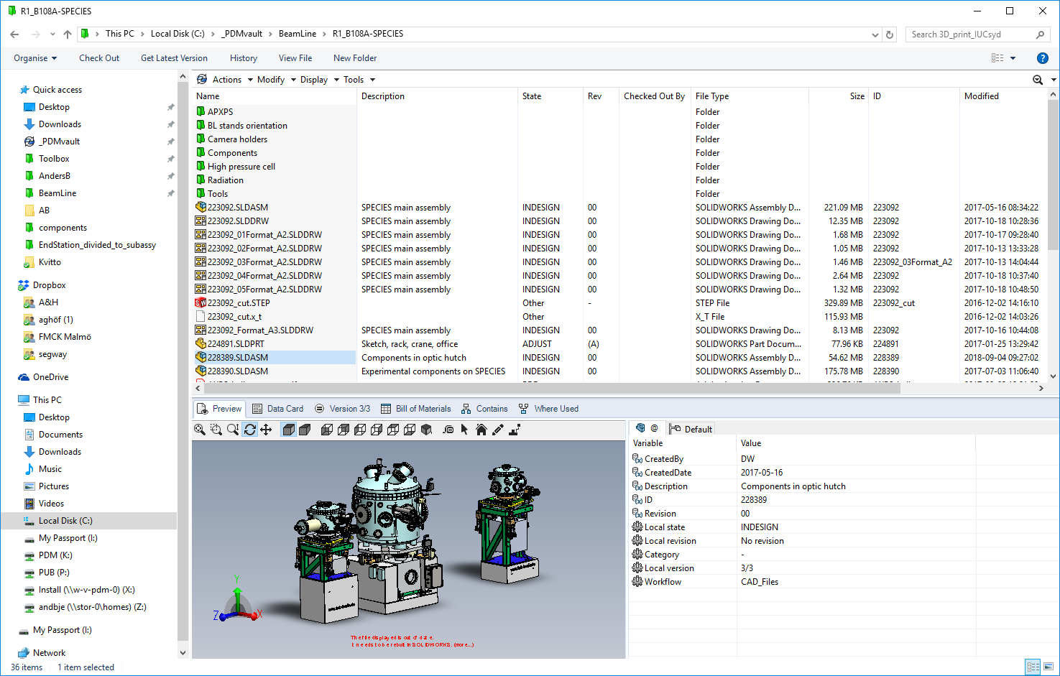

Slide 6
SolidWorks CAD “ Creates: Parts – Assemblies – Drawings – other files
A 3D-model is the base for creating a drawing
A change in a drawing always need a change of the model first
Two parts or more creates an assembly
A drawing from an assembly contains the BOM-list (Bill of Material)
SW can export and import many different file format The back side is that most often the imported parts and assemblies are not editable. We call them “dead parts”

Slide 7
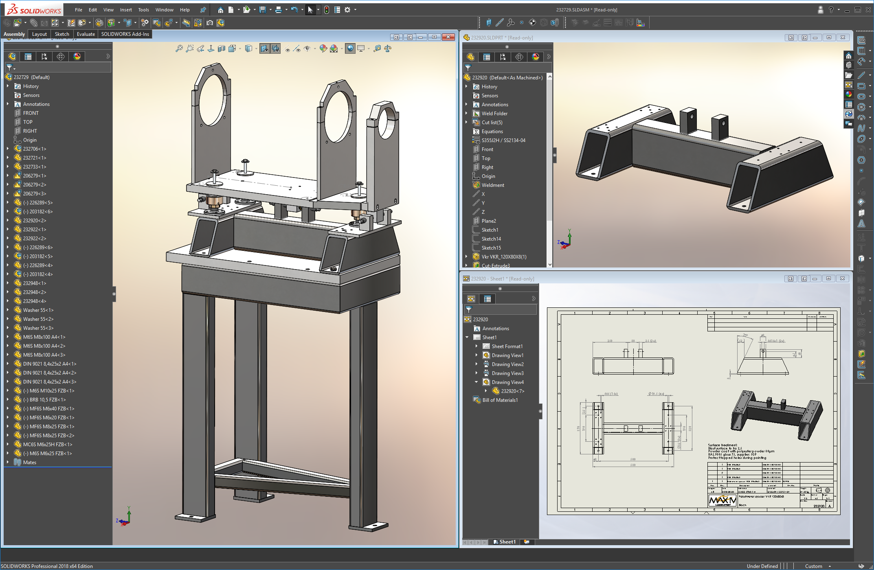

Slide 8
Some statistics about us and our system
We have 15 licenses SolidWorks PDM Professional
We have 10 licenses SolidWorks Professional CAD
We have our license on our server on the “white net”
The support cost for all licenses are ~200’ SEK/year
We have around 35 installations of SW/PDM at Max IV
We are four employees and three consultants at Design Office
We are a resource for Max IV at all levels for mechanical design
We have over 260.000 files on the PDM server and they consume almost 1 Tb of memory
We also have two licenses SolidWorks Simulation and one license of SolidWorks Flow Simulation
You need the PDM software to be able to see and open these files

Slide 9
Karl present how & what we simulate at Max IV

Slide 10
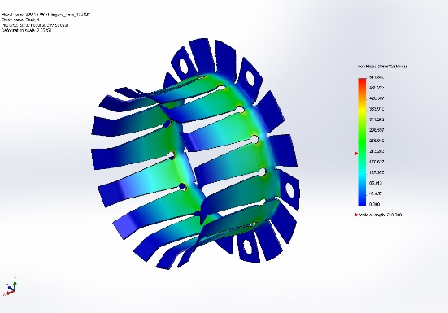
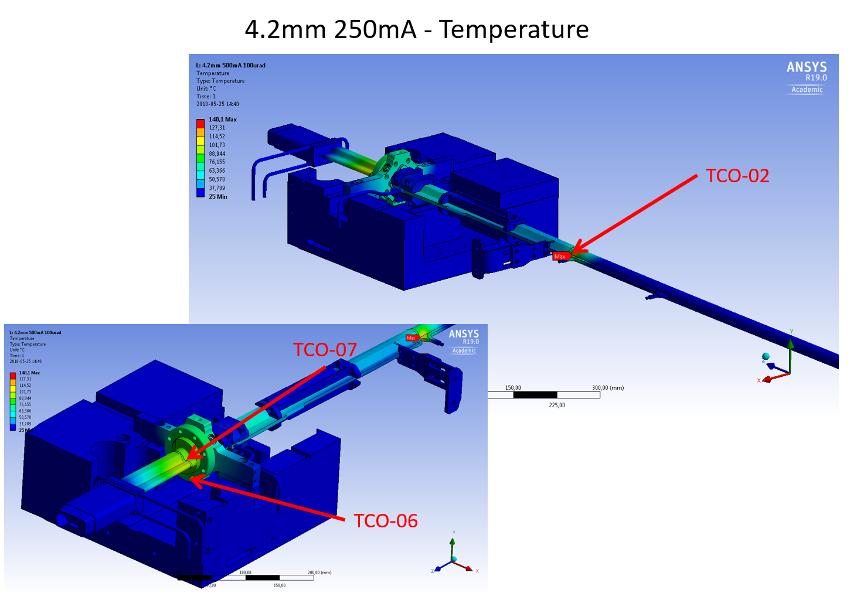
FEA
Stability
Development
Lifetime
Displacement
Temperatures
Stresses
Force
Troubleshooting
Raytracing in 3D

Slide 11
FEA - Software
Solidworks Simulation Integrated in CAD software enable fast changes in geometry. Limited in capability, capable in user interface
ANSYS Competent FEA software
SynRad+ Developed from MolFlow+ used for vacuum applicactions. It traces photons to calculate flux and power distribution. A magnetic region is defined either by formula or data. From this beam photons are emitted and reflectance and absorbance is calculated when it hit a surface. Complex 3D structures can be imported as *.stl, for example mirrors, heat absorbers, a full beamline or an achromat.

Slide 12
FEA Stability
Simple but complex
Stability goal of 55Hz
Everything is a spring. We can tell what the Eigen frequencies look like and what we can do to improve

Slide 13
FEA As a tool for development
Ref. Nanomax KB-mirror system
Stress in critical components
Lifetime
Vacuum forces
Chamber design
Transfer forces
Stability opimization
Positions of motors and supports
Mirror deflection
Mirror hanging on multiple pivot points. Theoretically eliminating the deflection down to pikometer level.

Slide 14
FEA As a tool for troubleshooting
Stability Visualizing eigenfrequencies can help us to improve stability and identify weak spots
Complex ray tracing in 3D with SynRad+
Hotspots
Evaluate lifetime
Analyze failure

Slide 15
Workflow VC02A R308M1(Balder)
SAM
Survey done for VC02A-009 prior installation
FMB
3D-model
Wiggler
Magnet field data for 4.2mm gap(Hamed)
SW VC02A modified to fit point data from SAM-team. Position(at TCO-02) changed in order to match Ansys result to Elog study
STL-file
SynRad+ Generate heat flux.
Solid model
Elog
Study with 5mm gap@20mA used to tune in position of chamber and boundary conditions
Ansys
Steady-state thermal
Static structural
W/mm² in xyz

Slide 16
SynRad+ Ray tracing in 3D
Imported STL
Power density
Beam position & angle
Beam parameters
Generated SR
Magnet field data
Magnet field(307M2 + Wiggler + 308M1)

Slide 17
Ansys Stitching power density from SynRad+ to Ansys

Slide 18
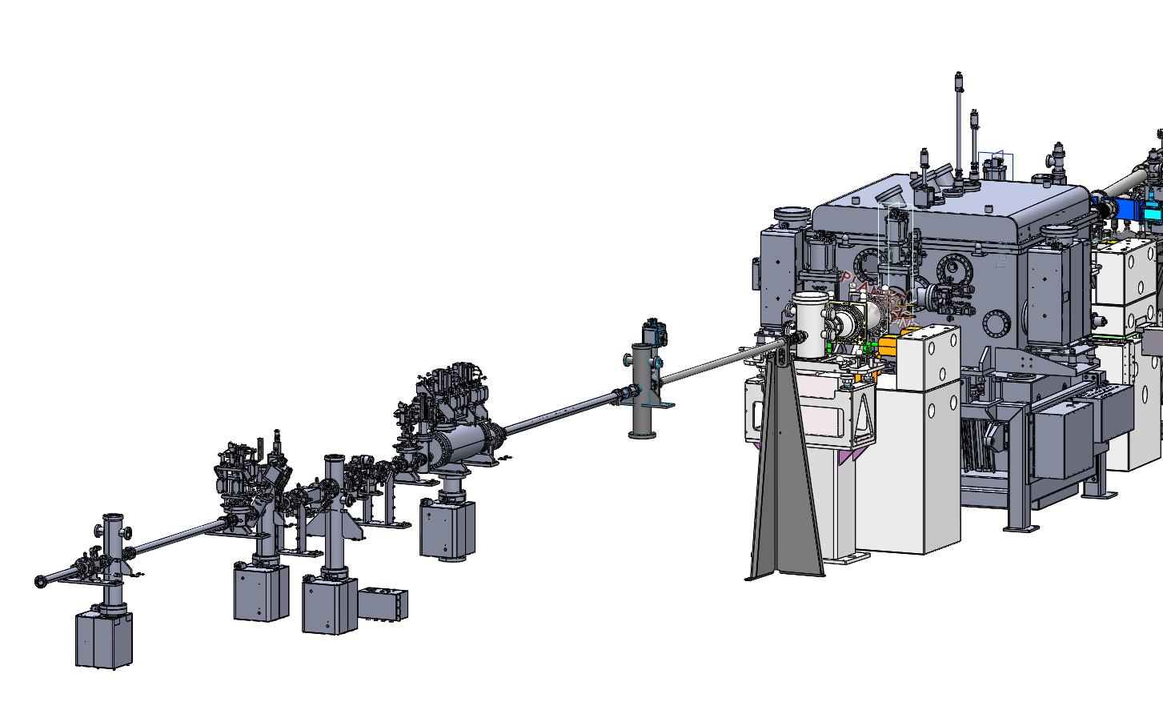
Future example? FMB mirror system M1 heating issues
CAD
SynRad+ ray tracing with reflections

Slide 19
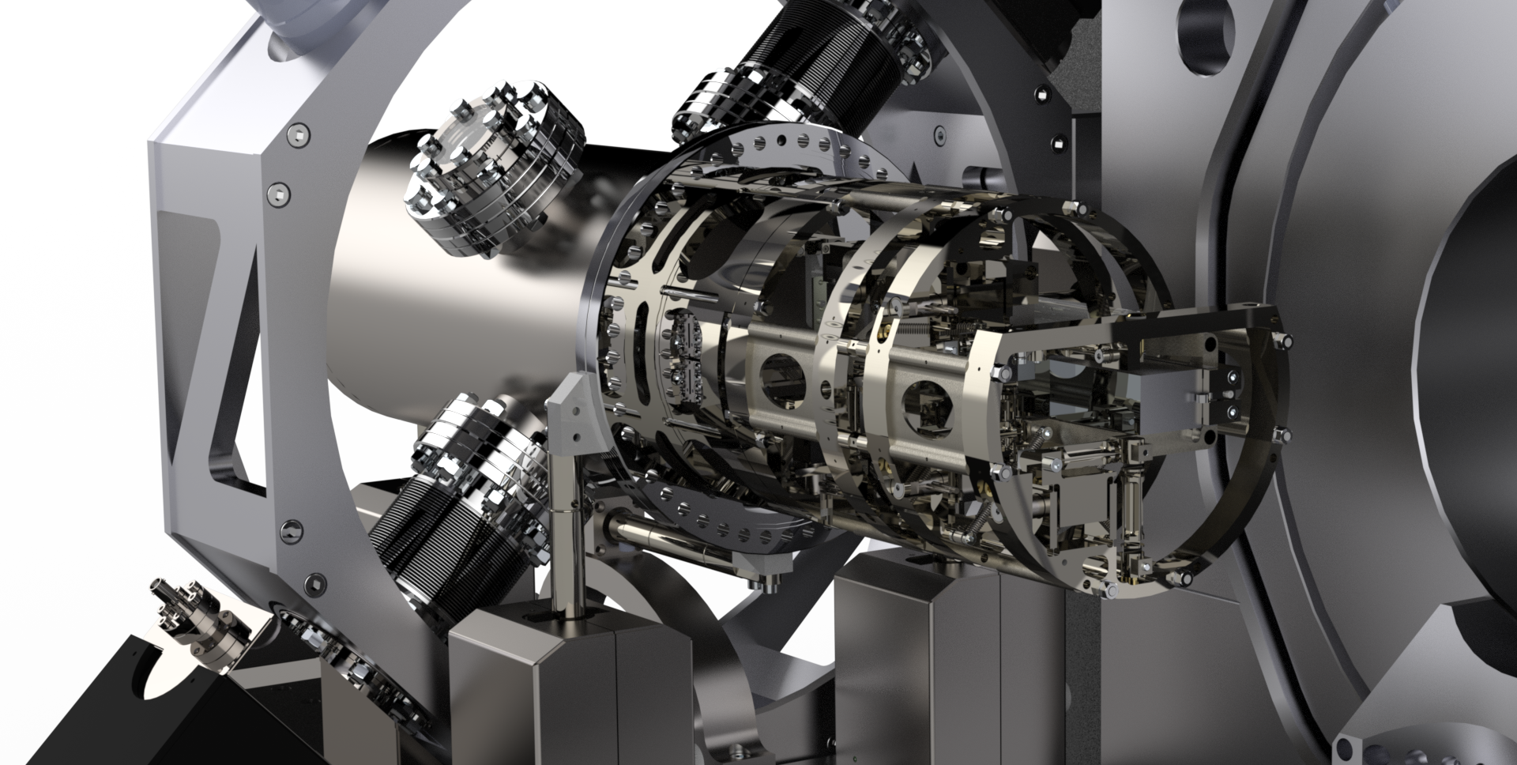
Mechanical design at Max IV

Slide 20
Where are we involved?
Gun Test
Linac
Injection
Storagerings
Diagnostics
RF
ID
Beamlines

Slide 21
In house development
NanoMAX Flight Tube
NanoMAX FZP End Station
SoftiMAX STXM End Station
CoSAXS End Station
TDC

Slide 22
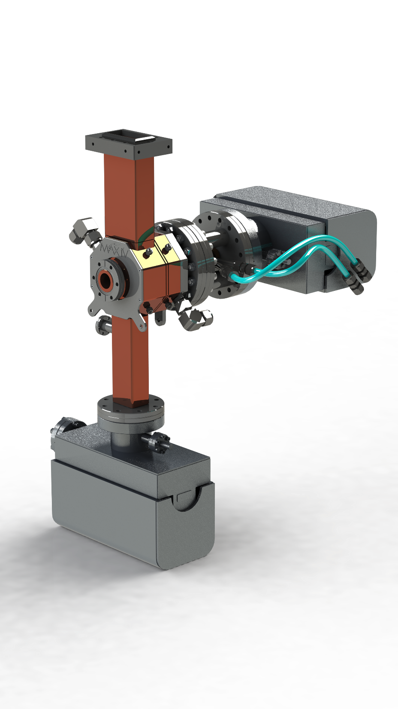
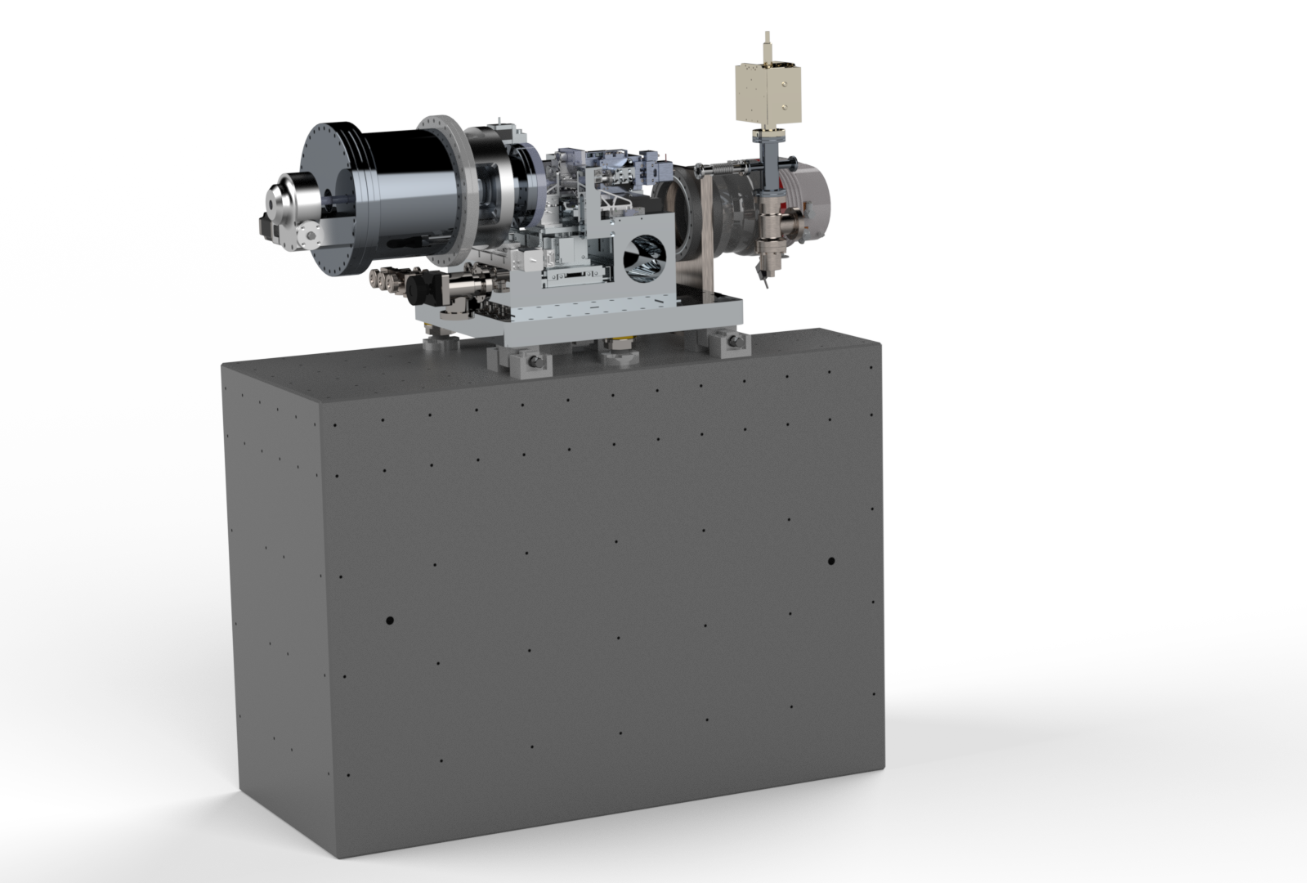

Slide 23
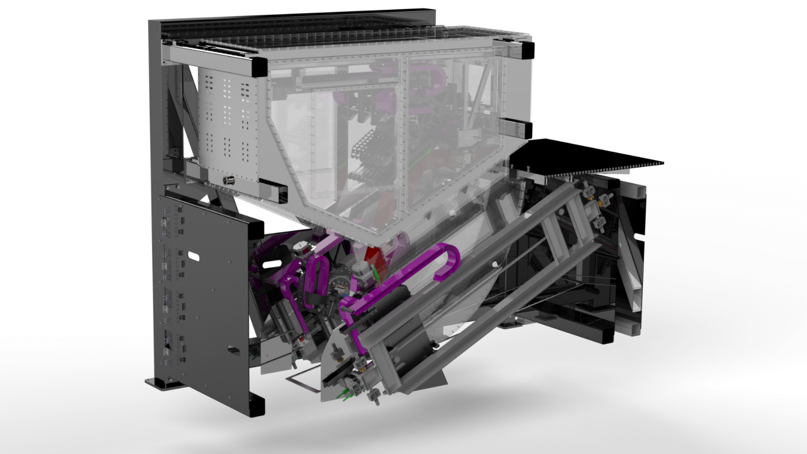
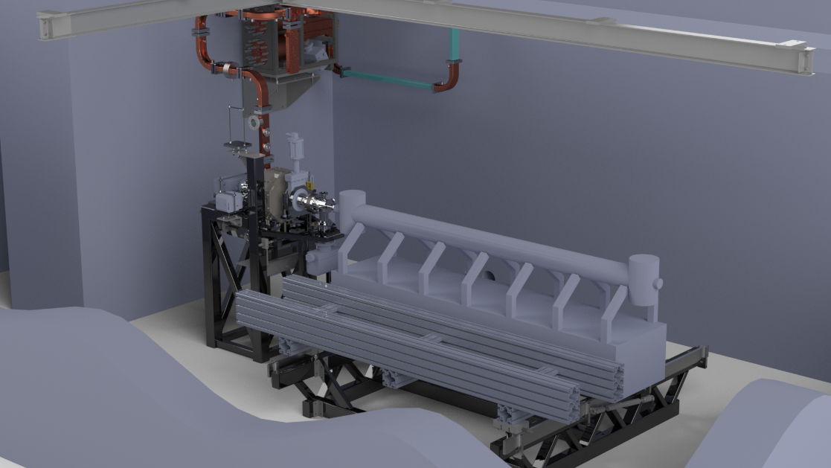
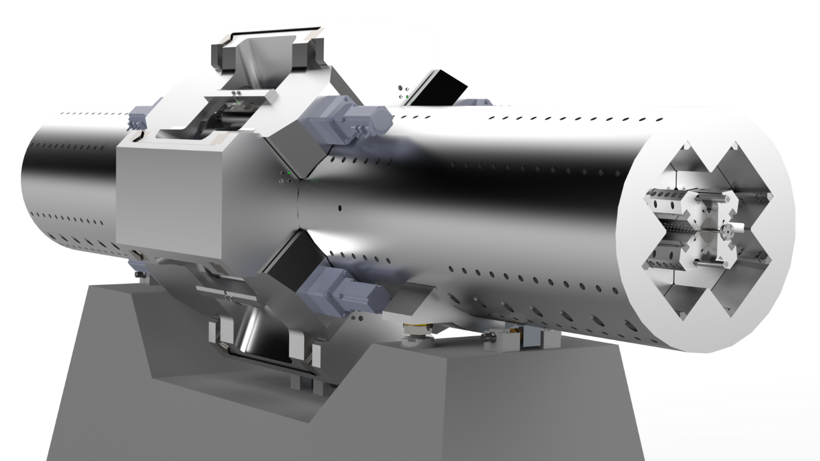

Slide 24
The Procedure
Request in person
We plan the work
Follow up
Final design decision
Drawings
Manufacture (in house/proccured)
Control after manufacture

Slide 25
Intranet

