Slide 1
PLC @ MAX IV
Who are we
Name: Email:
Claes Lenngren claes.lenngren@maxiv.lu.se
Jimmy Malmqvist jimmy.malmqvist@maxiv.lu.se
Jon Ragnemyr jon.ragnemyr@maxiv.lu.se
Jonas Lindkvist jonas.lindkvist@maxiv.lu.se
Niklas Jönsson niklas.jonsson@maxiv.lu.se
Svetolik Ivanovic svetolik.ivanovic@maxiv.lu.se
Tobias Jeppsson tobias.jeppsson@maxiv.lu.se
Consultants:
Bengt Rosengren bengt.rosengren@afconsult.com
Johan Grube johan.grube@afconsult.com
Lars Persson lars.persson@wimix.se

Slide 2
What we do
Main sub systems we work with:
Vacuum, Magnets, Gas, Cryo, Water, Ventilation, Insertion devices, PSS.
Electrical construction:
Produce electrical drawings & cable lists for electricians. Verify installation. Support with electrical issues.
PLC Programming / Commisioning:
Connect and control electrical components. Testing and verify that system is working as described.
Documentation:
Functional description, Test protocols, Naming convention, Cable database. Equipment & cable labels.

Slide 3
Best communication channel to reach us:
For emergency maintenance:
On-Call 046-222 69 70
Tickets:
espa@maxiv.lu.se
More information on what we do: https://intranet.maxiv.lu.se/machine-division/engineering/electrical-systems-and-plc-automation/

Slide 4
AFS2008:3
Arbetsmiljöverkets Författnings Samling
Operators Manual
Maintenance Manual
Installation Instructions
Notes:
Demands by law

Slide 5

Object oriented documentation
Overall documents. Described for any reader
Systems: Fire, Beamlines, Safety, Ring, Linac etc
Plant part: Fire in room A101730
Beamline B317A Functional Description
Beamline B317A Operators Manual
Beamline B317A SRP (safety)
Etc.

Slide 6
Object oriented documentation
Plant part: Fire in room A101730
Beamline B317A Functional Description
Beamline B317A Operators Manual
Beamline B317A SRP (safety)
Etc.

Slide 7
Objects
Object types.docx
https://alfresco.maxiv.lu.se/share/page/site/maxiv/document-details?nodeRef=workspace://SpacesStore/8daf032c-a0cb-44ae-bccf-e69f8348484a
Notes:
SEVERITY LEVEL
SMS

Slide 8
Objects
Alarm levels:
L1 – Immediate action
L2 – Take action following day
L3 – Plan for maintenance
L4 – Information only
L5 – Logging (automatic reset)
Object type:
Analogue
Read
, Type 1
Description:
A sensor will transmit an
analogue value. It can be for example be
4
-
20mA or 0
-
10V.
Specify type
of sensor here.
Function:
The object shall read analogue value and if necessary convert to engineer units. It must
supervise the value and set
WARNING
s and
ALARM
s in case limits are crossed.
It should indicate an alarm if value has an over range or under range
It should be configurable to enable High
High, High, Low and LowLow ALARM
and
WARNING
s.
Duration, filter time should be configurable.
Alarms/
Warning
:
Alarms
Equipment Fault
High High
Low Low
I
W
arning
nterface:
s
Type
Signal Id
Description
High
A
Low
I
A
I_
VALUE
Analogue value from sensor
A
TANGO
I
I_
HH_LIMIT
HighHigh Limit
:
Indications
Alarm status
A
Warning
status
I
I_
H_LIMIT
High Limit
A
Analogue Value in engineer units
I
I_L_LIMIT
Low Limit
A
Manoeuvres
I
I_LL_LIMIT
LowLow Limit
Disable
DI
I_RESET
Reset of alarm
Reset alarm
DI
I_DISABLE
If this signal is true the
control system will ignore alarms from the
High High limit value
AI
I_DURATION
Filter time in sec.
If AI_VALUE is below or above limits for this amount of
High Limit Value
time the Alarm and warnings outputs will be set.
Low Limit Value
Low Low Limit Value
DO
O_ALARM_HH
Value above HH limit
. Decide Level on alarm
DO
O_
WARNING
_H
Value above H limit
. Warning will get Level 4
DO
O_
WARNING
_L
Value below L limit
. Warning will get Level 4
DO
O_ALARM_LL
Value below LL limit
. Decide Level on alarm
DO
O_ALARM_FAULT
Value is out of range
. Equipment Fault
Notes:
DESCRIBE EACH SIGNAL
SEVERITY LEVEL
SMS

Slide 9
1.1.1
B111A_O01_DIA_TCO01
Object type:
Analogue
Read,
type 1
Description:
Mirror temperature sensor.
K
-
Function:
type thermocouple
Temperature in the front of M1. If the mirror temperature is too high (e.g. water cooling fails), it can affect
the integrity of the mirror and trigger vacuum losses. Therefore,
these must be treated the same way as
vacuum losses when detected.
Type
Signal Id
Signals
AI
AI_VALUE
0
–
41 mV (0
-
1000 C)
A
I
I_HH_LIMIT
3.682 mV (90 C)
AI
I_H_LIMIT
2.023 mV (50 C)
AI
I_L_LIMIT
NA
AI
I_LL_LIMIT
0.00 mV (0 C)
–
sensor fault
DI
I
_RESET
RESET from
TANGO
DI
I_DISABLE
DISABLE from
TANGO
AI
I_DURATION
1000 ms
DO
O_ALARM_HH
Level 2, mirror temperature is too high. Open manual valve nnn, SMS
DO
O_
WARNING
_H
Level 4
DO
O_
WARNING
_L
N/A
DO
O_ALARM_LL
Level 2
DO
O_ALARM_FAULT
Level 2
Notes:
OBJECT TYPE IS NOT THE PHYSICAL OBJECT
SENSOR FAULT

Slide 10
AI_B317A_EA04_VAC_TCO01
B317A_EA04_VAC_TCO01
I
nterface:
Type
Signal Id
Signals
A
TANGO
I
A
I_
VALUE
Analogue value 4-20mA
A
I
I_
HH_LIMIT
40 degC
A
I
I_
H_LIMIT
30 degC
A
I
I_L_LIMIT
NA
A
I
I_LL_LIMIT
NA
DI
I_RESET
From TANGO
B317A_EA04_VAC_VGMB01
DI
I_DISABLE
From TANGO
AI
I_DURATION
2 sec.
Type
Signal Id
Signals
DO
O_ALARM_HH
Level 2
DI
I_ENABLE
Not B317A_EA04_VAC_TCO01.O_ALARM_HH
DO
O_
WARNING_H
.Level 4
And not B317A_EA04_TCO01.O_ALARM_FAULT
DO
O_
WARNING_L
NA
DI
I_OPEN_C
From TANGO
DO
O_ALARM_LL
NA
DI
I_CLOSE_C
From TANGO
DO
O_ALARM_FAULT
Level 2
o
r
B317A_EA04_VAC_TCO01.O_WARNING_H
DI
I_OPEN_S
B317A_EA04_VAC_VGMB01.I
DI
I_CLOSE_S
B317A_EA04_VAC_VGMB01.I
DI
I_ RESET
From TANGO
DI
I_DISABLE
From TANGO
AI
I_DURATION
2 s
DO
O_OPEN
B317A_EA04_VAC_VGMB01.Q
DO
O_ALARM
Level 1

Slide 11
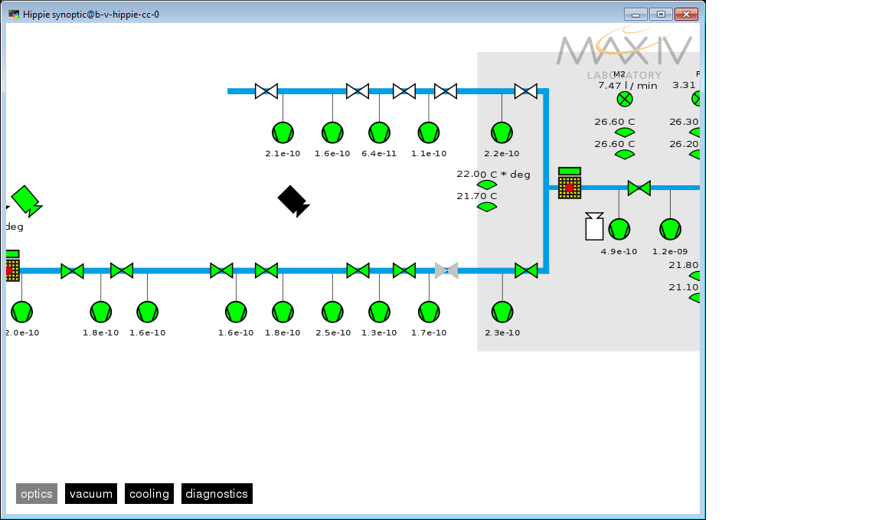
Not B317A_EA04_VAC_TCO01.O_ALARM_HH
And not B317A_EA04_TCO01.O_ALARM_FAULT

Slide 12
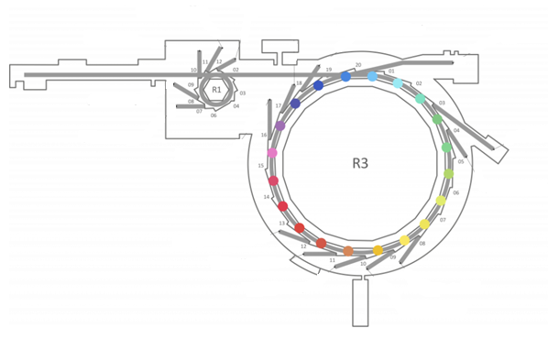
PLC system
What is our definition of Beamline?

Slide 13
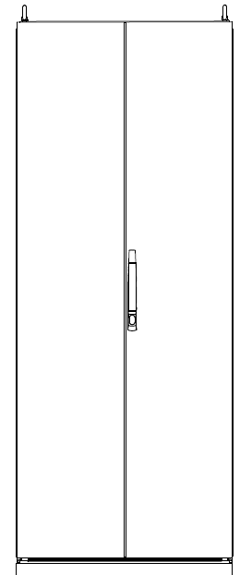
EndStation
Optics
FrontEnd

Slide 14
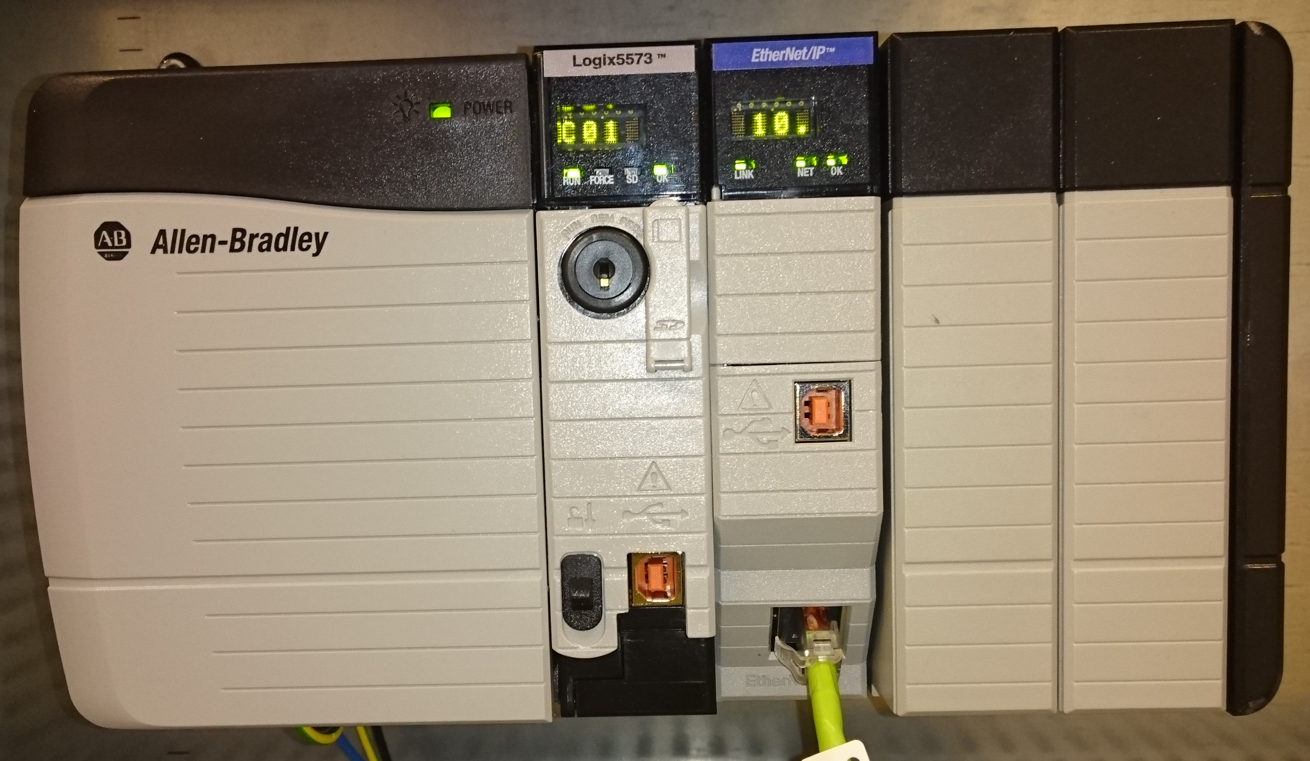
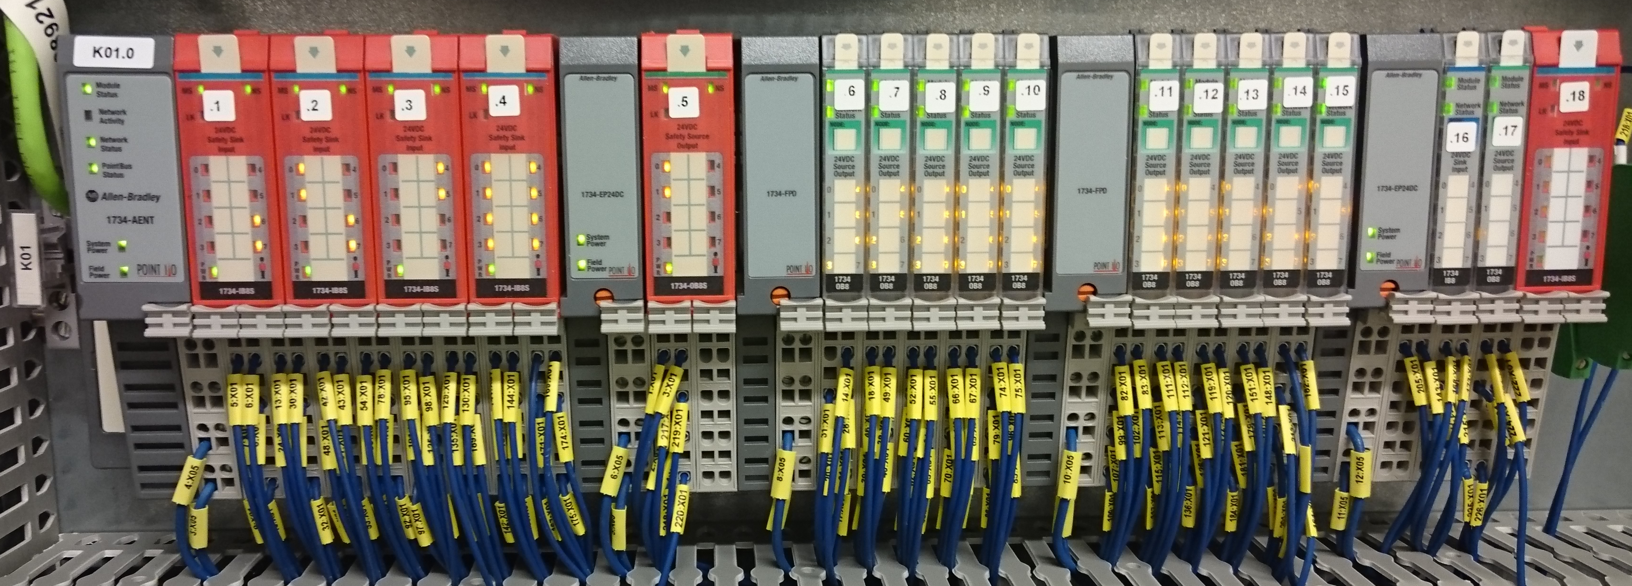
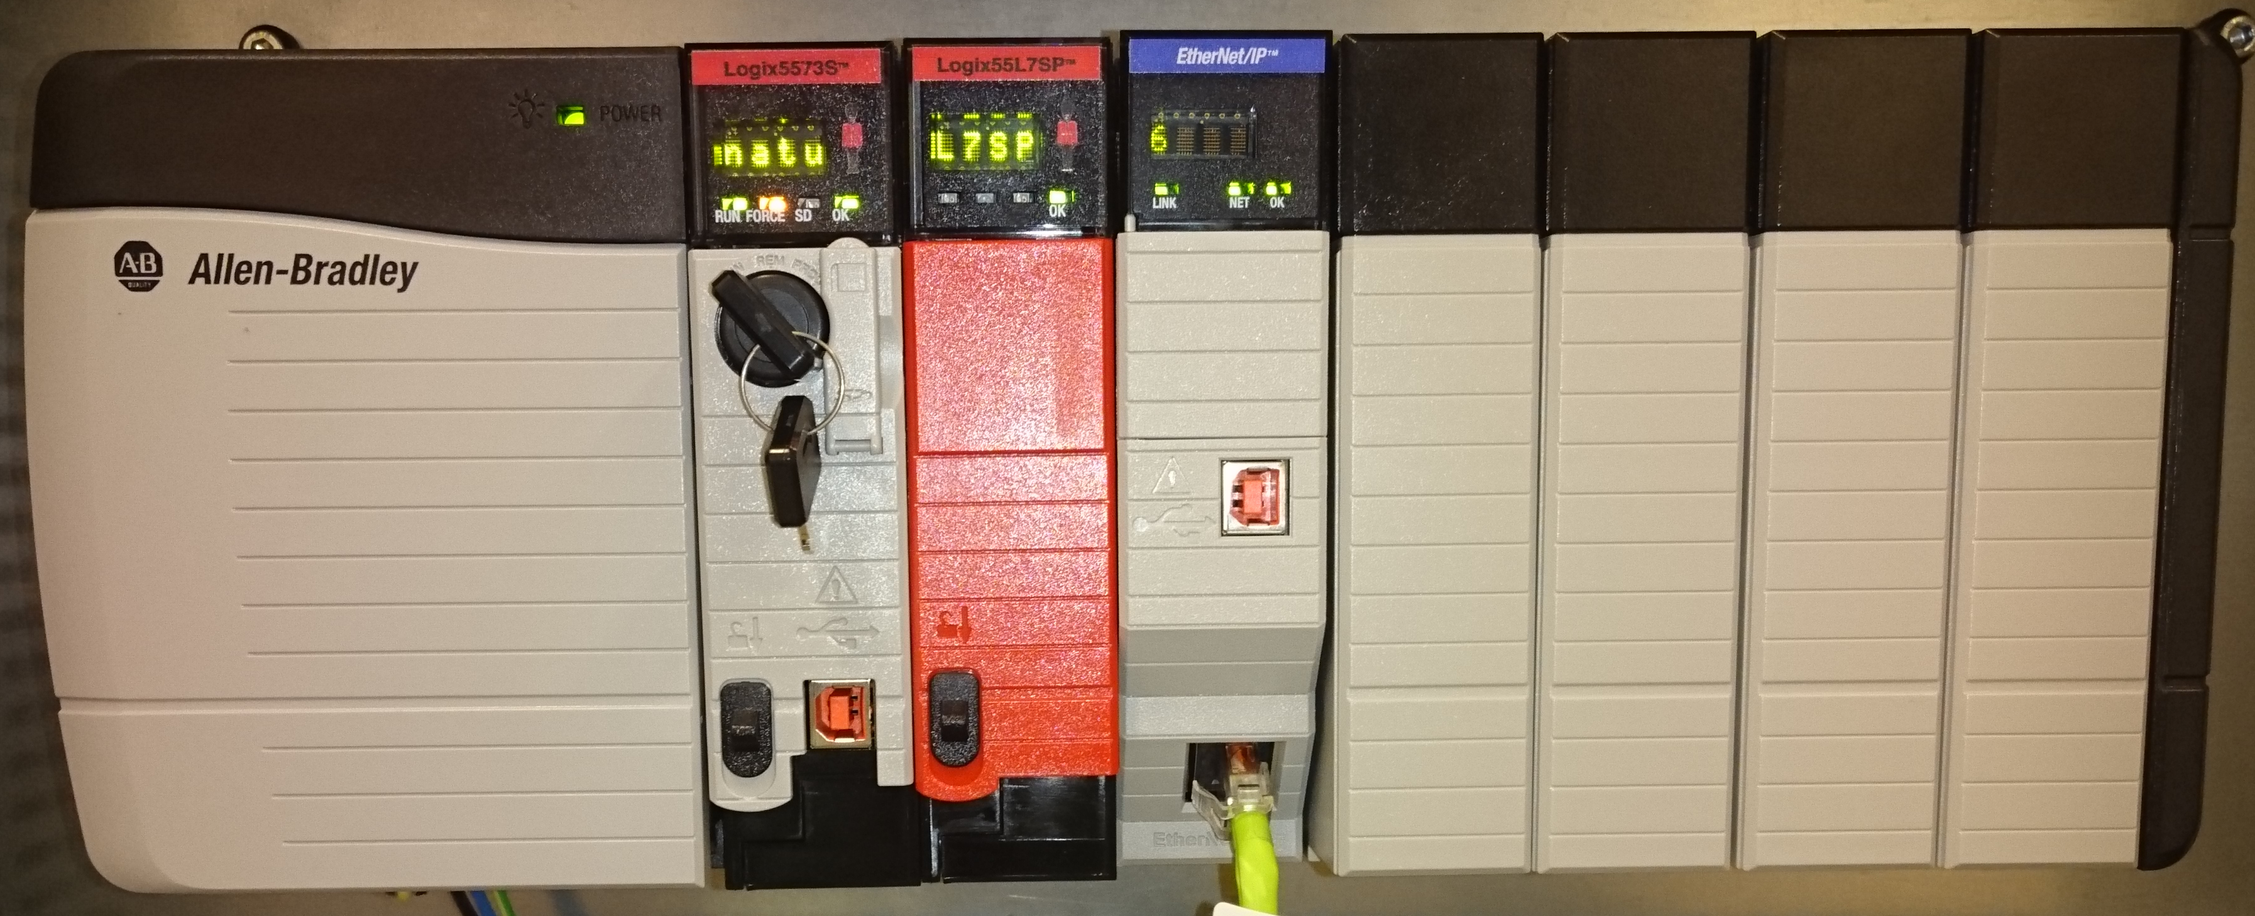
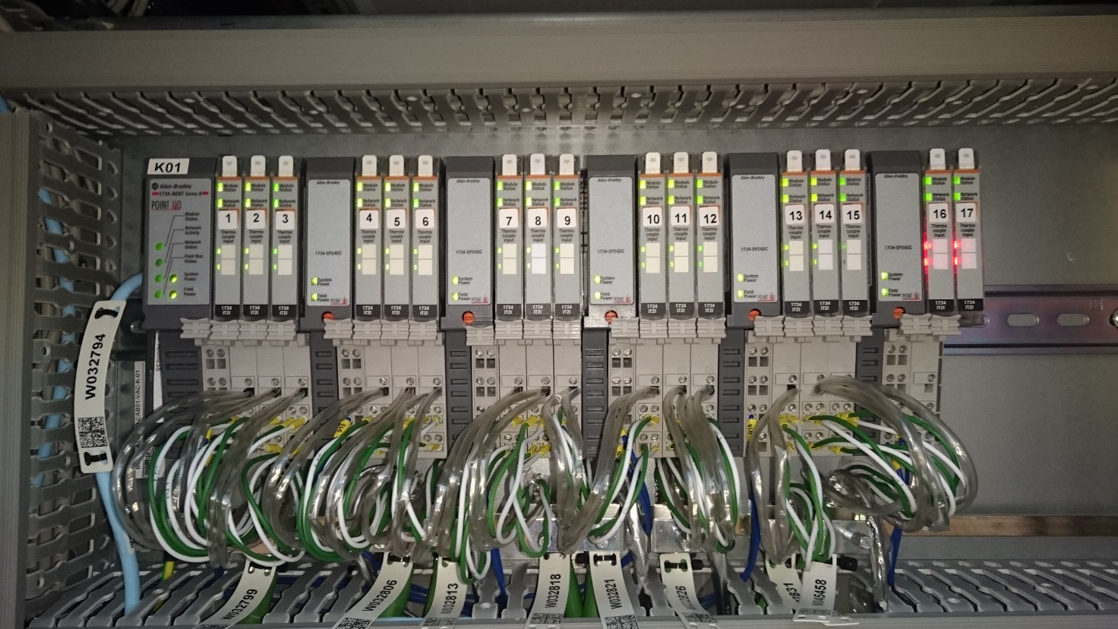
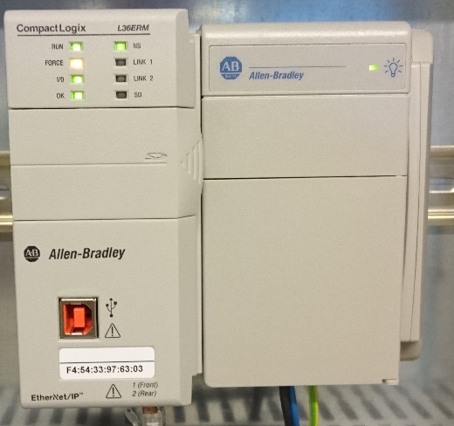
ROCKWELL
TANGO/SYNOPTIC
Sensors ex. : TCO
PLC
Point IO
(Distributed IO)
Ethernet
SWITCH
Sensors ex. : VacuumGauges

Slide 15
ROCKWELL
TANGO/SYNOPTIC
Sensors ex. : TCO
PLC
Point IO
(Distributed IO)
Ethernet
SWITCH
Alarm
Sensors ex. : VacuumGauges

Slide 16
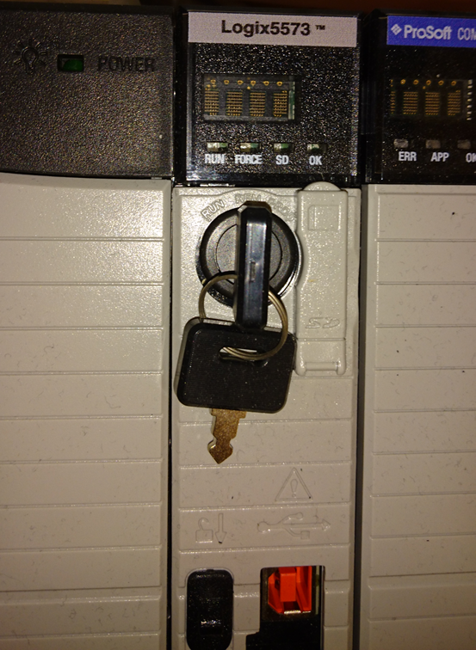

RUN – Code is executed and cannot be reprogrammed
REM – Code is executed and can be reprogrammed
”Maintenace Mode”
PROG – Code is not executed and can be reprogrammed
SD card holder. Here we store all settings made in TANGO

Slide 17
LINAC (ID, MAG, VAC, WAT, PSS)
R1(ID, MAG, VAC, WAT, PSS)
R3 (ID, MAG, VAC1&2, WAT, PSS)
Beamlines (R1 2-12, R3 1-20, FemtoMax)
G (CRY, PSS, Guntest)

Slide 18
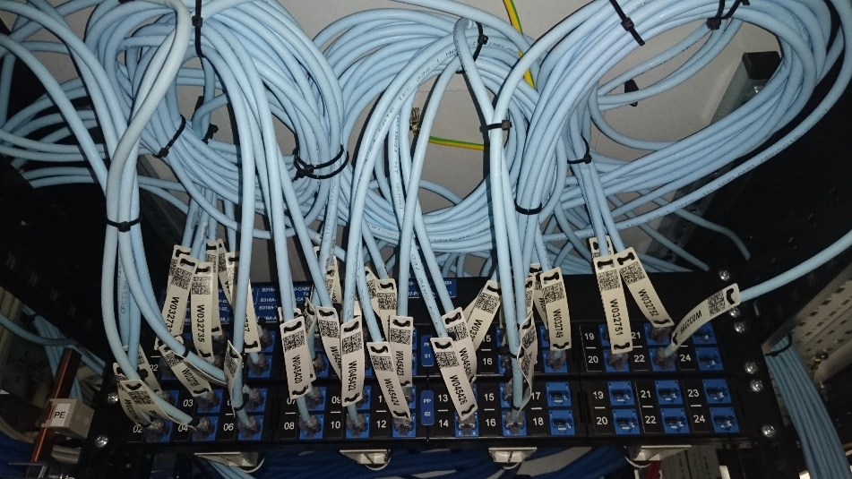
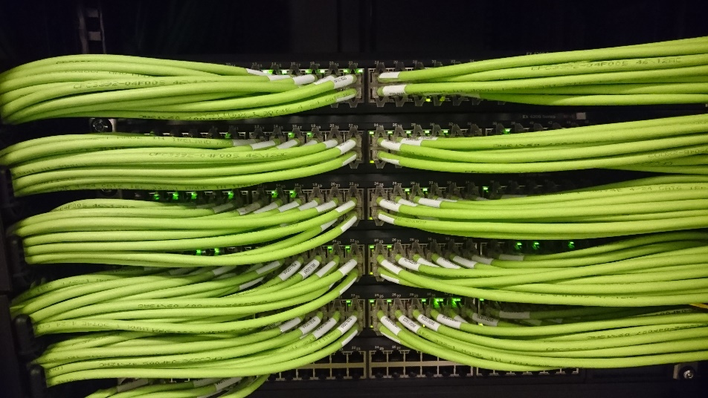
LINAC (ID, MAG, VAC, WAT, PSS)
R1(ID, MAG, VAC, WAT, PSS)
R3 (ID, MAG, VAC1&2, WAT, PSS)
Beamlines (R1 2-12, R3 1-20, FemtoMax)
G (CRY, PSS, Guntest)

Slide 19
Beamline PLC
Ring PLC
SWITCH
Ex. SoftiMax 172.16.206.9
R3 PLC02 10.0.124.5
Produce data to other PLC
Running
Ready for light
Temperatures are ok
Consume data from other PLC SoftiMax 172.16.206.9
Running
Ready for light
Temperatures are ok
Notes:
HOW DO THEY COMMUNICATE
GREEN AND BLUE NETWORK

Slide 20
Beamline PLC
Ring PLC
SWITCH
Ex. SoftiMax 172.16.206.9
R3 PLC02 10.0.124.5
Consume data from other PLC R3 PLC02 10.0.124.5
Running
Beam on
Produce data to other PLC
Running
Beam on

Slide 21
R1_101S – 103S
101S_VAC_VGRC01
101S_VAC_V9MB01
101S_VAC_IPH01
101S_VAC_IPFE01
101_VAC_V9MB01
101_VAC_IPFE01
101_VAC_HAA01
101_VAC_VGMB01
101_VAC_V9MB02
102S_VAC_V9MB01
102S_VAC_VGRC02
102_VAC_V9MB01
102_VAC_IPFE01
102_VAC_HAA01
102_VAC_VGMB01
102_VAC_V9MB02
103S_VAC_V9MB01
103S_VAC_VGRC02
101S_VAC_IPFA01
101S_VAC_VGMB01
101_VAC_IPFN01
101_VAC_IPFN02
102S_VAC_IPGA01
102S_VAC_IPGA02
102_VAC_IPFN01
102_VAC_IPFN02
103S_VAC_IPGA01
103S_VAC_IPGA02
Notes:
DESCRIBE HOW IT WORKS TODAY
CORRECT OR NOT???

Slide 22
Beamline PLC PRODUCED to Ring PLC
O_CLOSE_FIRST_VALVE_ONCE | This will close VGMB01 once and close HAA01 once Create an alarm ”Valve Interlock from Beamline to R1”
O_CLOSE_SECOND_VALVE_ONCE | This will close VGRC01 once and close VGRC02 once Create an alarm ”Valve Interlock from Beamline to R1”
O_FE_CLOSED | This will creat an indication in TANGO that Front end is closed
O_FE_OK_TO_OPEN | This will creat an indication in TANGO that it is possible to open Front end
O_FE_OPEN | This will creat an indication in TANGO that Front end is open
O_FIRST_VALVE_INTERLOCK | (False = Interlock is true) This will close VGMB01 and close HAA01. They will remain closed Create an alarm ”Valve Interlock from Beamline to R1”
O_ID_OPEN_REQUEST | Not implemented in Ring PLC. TBA
O_MAINT_MODE_REQUEST | PLC key in REMOTE position HAA01 will be closed and remained closed VGMB01 will be closed and remained closed In case VGMB01 or HAA01 is NOT closed, this will dump the ring beam
O_LEAVE_MAINT_MODE_REQUEST | PLC key in RUN position, no action taken

Slide 23
Beamline PLC PRODUCED to Ring PLC
O_CLOSE_FIRST_VALVE_ONCE | This will close VGMB01 once and close HAA01 once Create an alarm ”Valve Interlock from Beamline to R1”
O_CLOSE_SECOND_VALVE_ONCE | This will close VGRC01 once and close VGRC02 once Create an alarm ”Valve Interlock from Beamline to R1”
O_FE_CLOSED | This will creat an indication in TANGO that Front end is closed
O_FE_OK_TO_OPEN | This will creat an indication in TANGO that it is possible to open Front end
O_FE_OPEN | This will creat an indication in TANGO that Front end is open
O_FIRST_VALVE_INTERLOCK | (False = Interlock is true) This will close VGMB01 and close HAA01. They will remain closed Create an alarm ”Valve Interlock from Beamline to R1”
O_ID_OPEN_REQUEST | Not implemented in Ring PLC. TBA
O_MAINT_MODE_REQUEST | PLC key in REMOTE position HAA01 will be closed and remained closed VGMB01 will be closed and remained closed In case VGMB01 or HAA01 is NOT closed, this will dump the ring beam
O_LEAVE_MAINT_MODE_REQUEST | PLC key in RUN position, no action taken
O_RF_INTERLOCK | (Must be true to allow light) In case VGMB01 or HAA01 is NOT closed, this will dump the ring beam Create an alarm ”RF dumps from Beamline”

Slide 24
  R3_VAC_PLC01_PRODUCED

Slide 25
Beamline PLC PRODUCED to Ring PLC
O_FIRST_VALVE_INTERLOCK | (False = Interlock is true) This will close VGMB01 and close HA001. They will remain closed Create an alarm ”Valve Interlock from Beamline to R3”
SoftiMax
DO | O_FIRST_VALVE_INTERLOCK | not B318A_A101830_CAB03_IPCUA01.O_ALARM and not B318A_A101830_CAB03_IPCUA02.O_ALARM and not B318A_A101830_CAB03_IPCUA03.O_ALARM and not B318A_A101830_CAB03_IPCUA04.O_ALARM and not B318A_A101830_CAB03_IPCUA05.O_ALARM and not B318A_FE_DIA_TCO01.O_ALARM_HH and not B318A_FE_DIA_TCO02.O_ALARM_HH and not B318A_FE_DIA_TCO03.O_ALARM_HH and not B318A_FE_DIA_TCO04.O_ALARM_HH and not B318A_FE_DIA_TCO05.O_ALARM_HH and not B318A_FE_DIA_TCO06.O_ALARM_HH and not B318A_FE_DIA_TCO07.O_ALARM_HH and not B318A_FE_DIA_TCO08.O_ALARM_HH

Slide 26
Beamline PLC CONSUME from Ring PLC
I_BEAM_ON | Ring current measured from DCCT > 4 mA. Means there's light and could be heat.
I_CLOSE_FE | Command bit to close FE on 1. If it is 0, you can open HA01, FE_VGMB02 and BS01/BS02.
I_CLOSE_FIRST_VALVE_ONCE | Command bit to close first valve (FE_VGMB02)
I_CLOSE_SECOND_VALVE_ONCE | Command bit to close second valve (FE_VGMB03)
I_FIRST_VALVE_INTERLOCK | Close first valve and keep it closed (FE_VGMB02)
I_HAA01_CLOSED | Ring PLC has closed the HAA01. (SCRN01, Screen will be retracted)
I_ID_OPEN | Not used, TBA
I_INTERLOCK_FE | This will close and keep closed: HA01, VGMB02 and BS01/BS02.
I_MAINTENACE_MODE | Feedback that Ring PLC has read Beamline PLC has turned key
I_OPEN_FE | This will open FE_VGFA, FE_VGMB02, FE_VGMB03, FE_VGMB04, O02_VGMB01, O02_VGMB02, BS01/BS02 and HA01.
I_RESET_BL | Resets alarms in bemaline
I_COMMUNICATION | If communication stops or Ring PLC is not running, an alarm will be raised ” Communication fault to PLC01 in 1.5 GeV” This will close and keep closed: HA01

Slide 27
  R3_VAC_PLC01_CONSUMED
Object type:
Consume
, Type 1
Description:
All signals that are read from Ring PLC system
Function:
To be used as information and interlocks
Interface:
Type
Signal Id
Description
DI
I_BEAM_ON
Alternatively, Light On? 1 means there's light and could be heat. (R
-
BL)
DI
I_
CLOSE_FE
Command bit to close FE on 1. Default 0 allows open HA01, FE_VGMB02
DI
I_CLOSE_FIRST_VALVE_ONCE
Command bit. Close valve on
rising flank.
DI
I_CLOSE_SECOND_VALVE_ONCE
Command bit. Close valve on rising flank.
DI
I_FIRST_VALVE_INTERLOCK
Permissive bit. Close valve when 0 and keep it closed. Must be 1 to allow
DI
I_
HAA01_CLOSED
Status bit, indicates that HA0_01 is closed
DI
I_
ID_OPEN
Status bit, indicat
e
s that ID is fully opened
DI
I_INTERLOCK_FE
Interlock bit for Front End. 1=allow open, 0=keep closed (R
-
BL)
DI
I_
MAINTENANCE_MODE
Beamline Maintenance Mode is selected
DI
I_
OPEN_FE
Command bit to open FE on 1.
DI
I_
HEAT_ABSORBER_INTERLOCK
Permissive bit. Close Heat Absorber when 0 and keep it closed. Must be 1
DI
I_
RESET_BL
to allow OPEN.
Command bit. Resets beamline on rising edge
DI
I_COMMUNICATION
Key in Run mode
and
Checks communication to controller
DO
O_ALARM
Not I_RUN_MODE or I_CONNECTION_FAULTED

Slide 28
Beamline PLC PRODUCED to PSS PLC
O_CLOSE_BD | Close Beam Dumps
O_CLOSE_BS | Close Beam shutter
O_OPEN_BD | Open Beam dump
O_OPEN_BS | Open Beam shutter

Slide 29
Beamline PLC CONSUME from PSS PLC
I_OK_TO_OPEN_BD | It is ok to open Beam Dump
I_BD01_OPEN | Beam dump 01 open
I_BD02_OPEN | Beam dump 02 open
I_BD01_CLOSE | Beam dump 01 closed
I_BD02_CLOSE | Beam dump 02 closed
I_OK_TO_OPEN_BS | It is ok to open Beam Shutter
I_BS01_OPEN | Beam shutter 01 open
I_BS02_OPEN | Beam shutter 02 open
I_BS01_CLOSE | Beam shutter 01 closed
I_BS02_CLOSE | Beam shutter 02 closed
I_ENABLE_KEY_IN_PLACE | Enable keys are in place and locked
I_OK_WITH_OPEN_HA | Beamshutters, Front End Heat absorber and communication to VAC system is ok

Slide 30
PLC are communicating with
Data areas called:
Consumed
Produced
PSS
VAC
Beamline
VAC
Linac
Ring
ID

Slide 31
Hardware failure
Each point IO card is sending a status code.
If any card status indicates fault, an alarm will be raised

Slide 32
Hardware failure in functional description
B317A_A101730CAB08_VAC_K06
Object type: Node Checker, Type 1
Description: Hardware control
Type | Signal Id | Signals
DI | I_ MODULE_OK | B317A_A101730CAB08_VAC_K06 in alarm or B317A_A101730CAB08_VAC_K06_01 in alarm or B317A_A101730CAB08_VAC_K06_02 in alarm or B317A_A101730CAB08_VAC_K06_03 in alarm
DO | O_ ALARM | Level 1
Temperature TCO02
B317A_EA10_VAC_VGOC01
Type: Valve, type 1
Description: 63CF valve between Anode and Mono chamber
Function: isolate X-ray anode from mono chamber
Type | Signal Id | Signals
DI | I_ENABLE | Not B317A_EA10_VAC_TCO02.HH_Alarm Not B317A_A101730CAB08_VAC_K06_01 in alarm (this points to a specific card) Not B317A_A101730CAB08_VAC_K06.O_ALARM (this cover the whole node)
DI | I_OPEN_C | From TANGO
DI | I_CLOSE_C | From TANGO
DI | I_OPEN_S | B317A_EA10_VAC_VGOC01_OPEN.S
DI | I_CLOSE_S | B317A_EA10_VAC_VGOC01_CLOSE.S
DI | I_ RESET | From TANGO
DI | I_DISABLE | From TANGO
AI | I_DURATION | 2 s
DO | O_OPEN | B317A_EA10_VAC_VGOC01_OPEN.Q
DO | O_ALARM | Level 1

Slide 33
PLC Function control
I_OPEN_FE_C | This will open FE_VGFA, FE_VGMB02, FE_VGMB03, FE_VGMB04, O02_VGMB01, O02_VGMB02, BS01/BS02 and HA01.
I_CLOSE_FE_C | This will close HA01, FE_VGMB02 and BS01/BS02.

